Slide 1

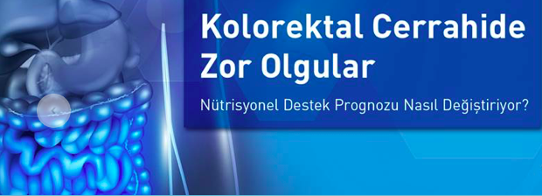

İnflamatuvar Barsak Hastalığında
Nutrisyonel Sorunlar ve Doğru Çözümleme
Ahmet Rencüzoğulları
Çukurova Üniversitesi Tıp Fakültesi Genel Cerrahi AD
Kolorektal Cerrahi Birimi
26/10/2019

Slide 2


Slide 3
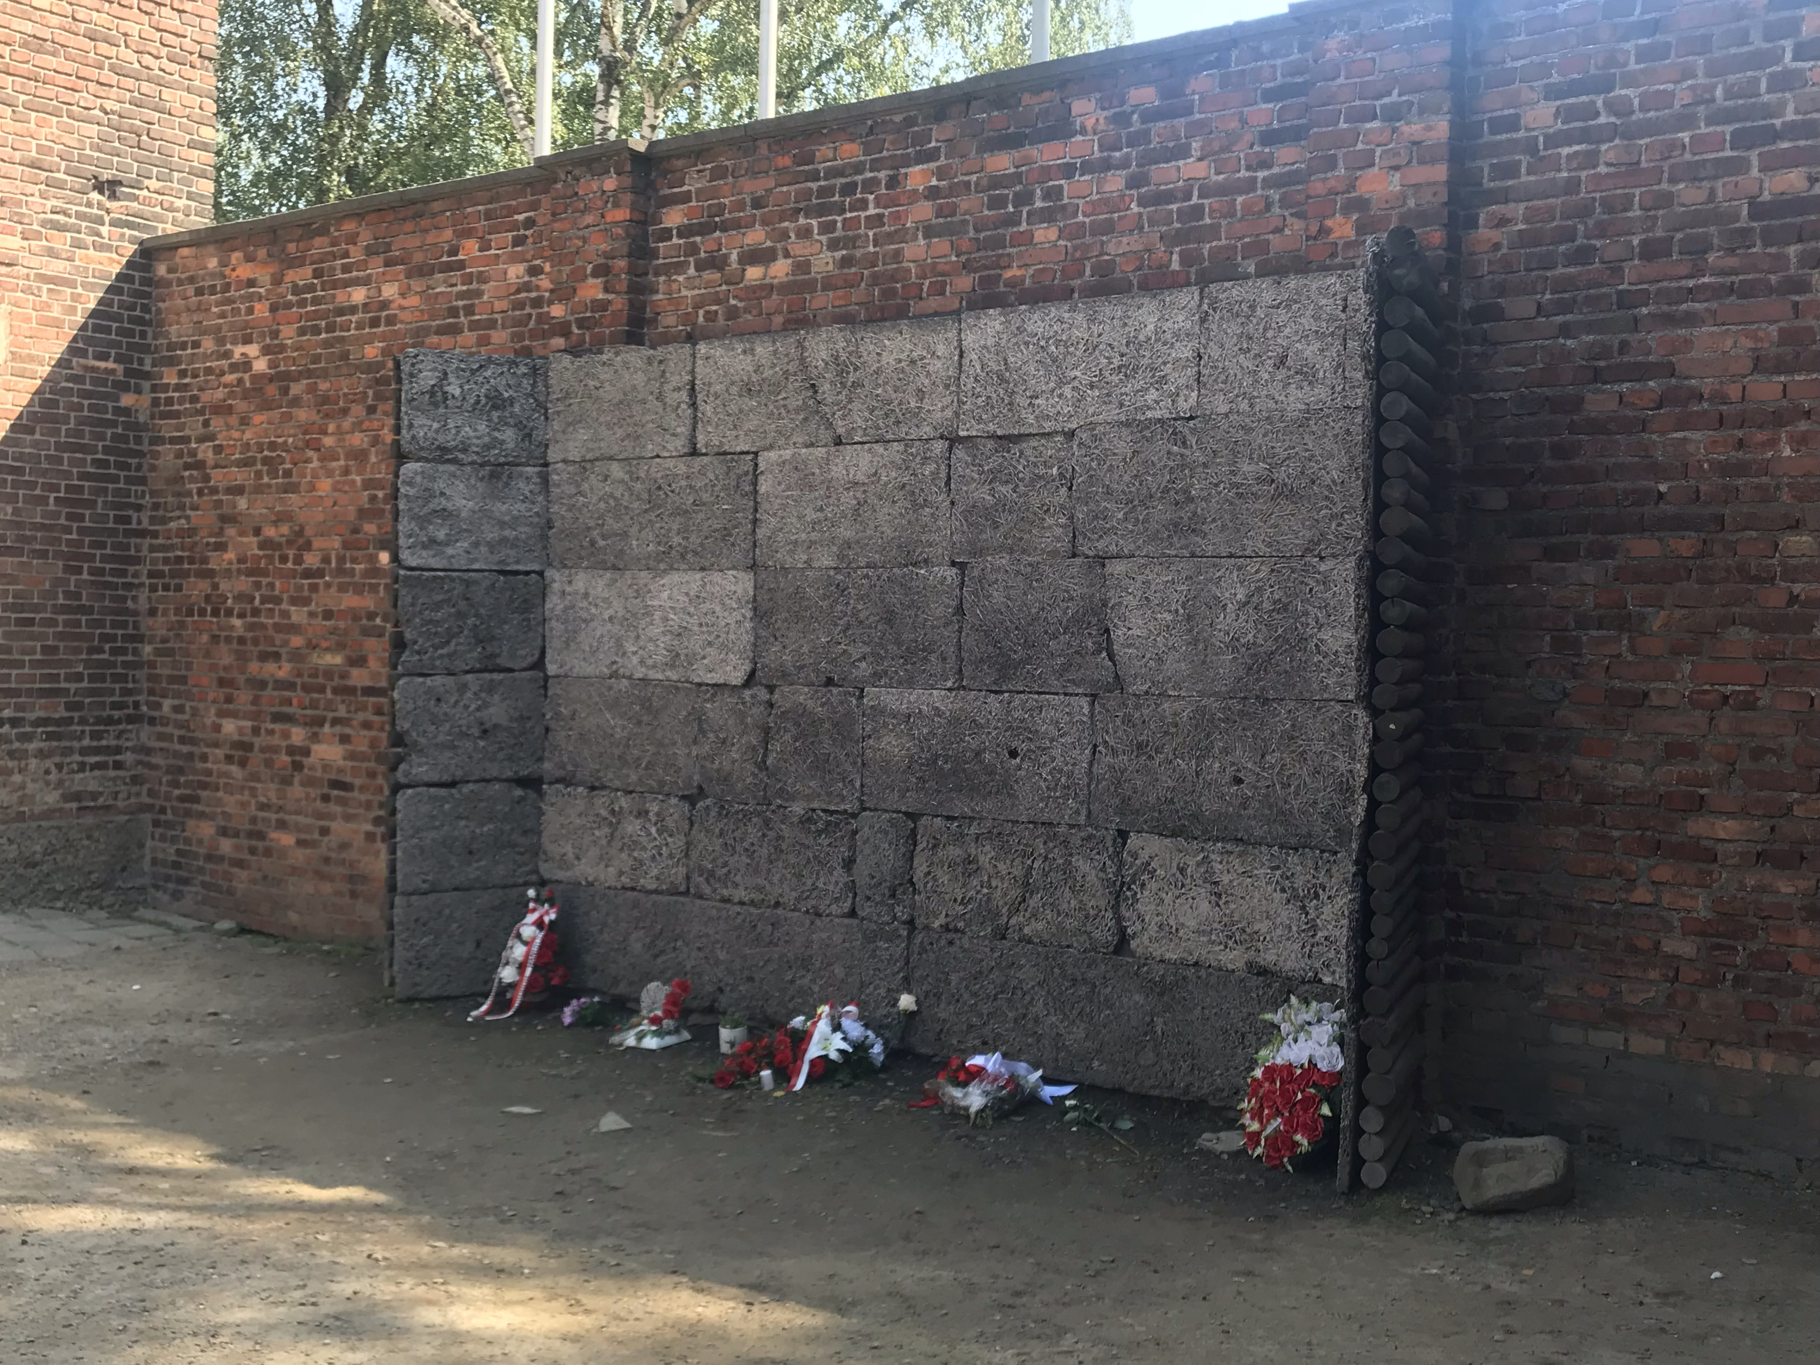

Slide 4
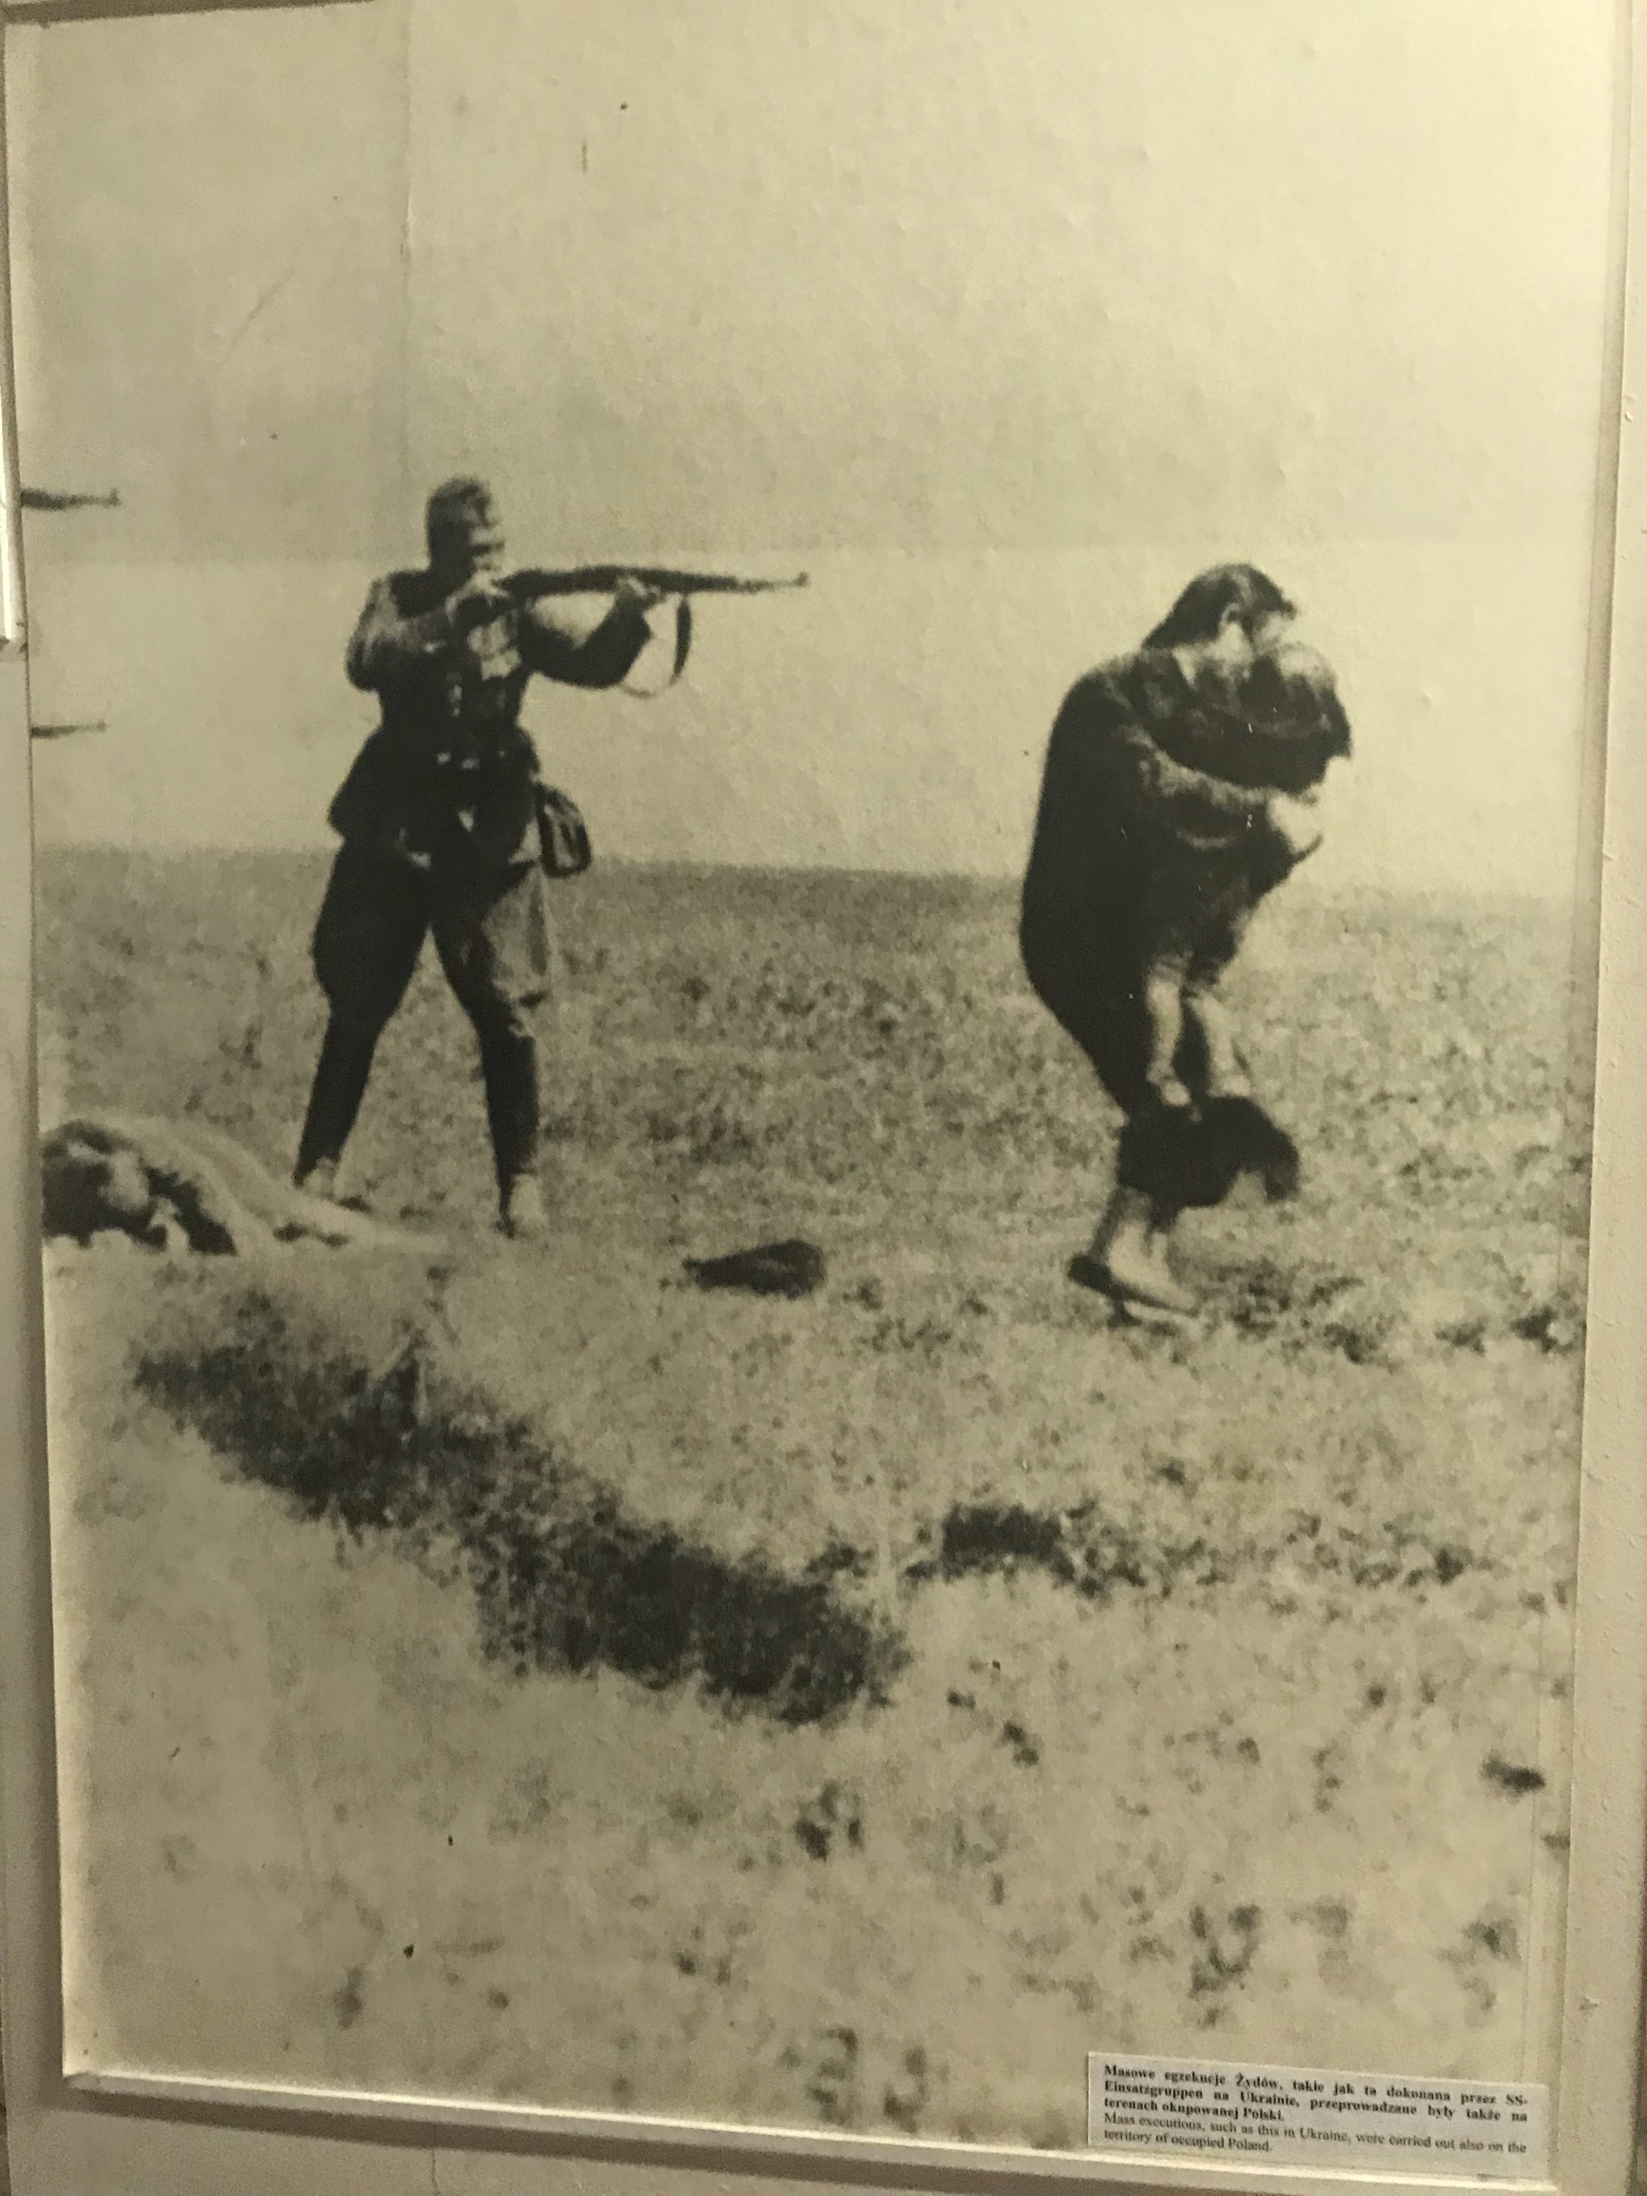

Slide 5
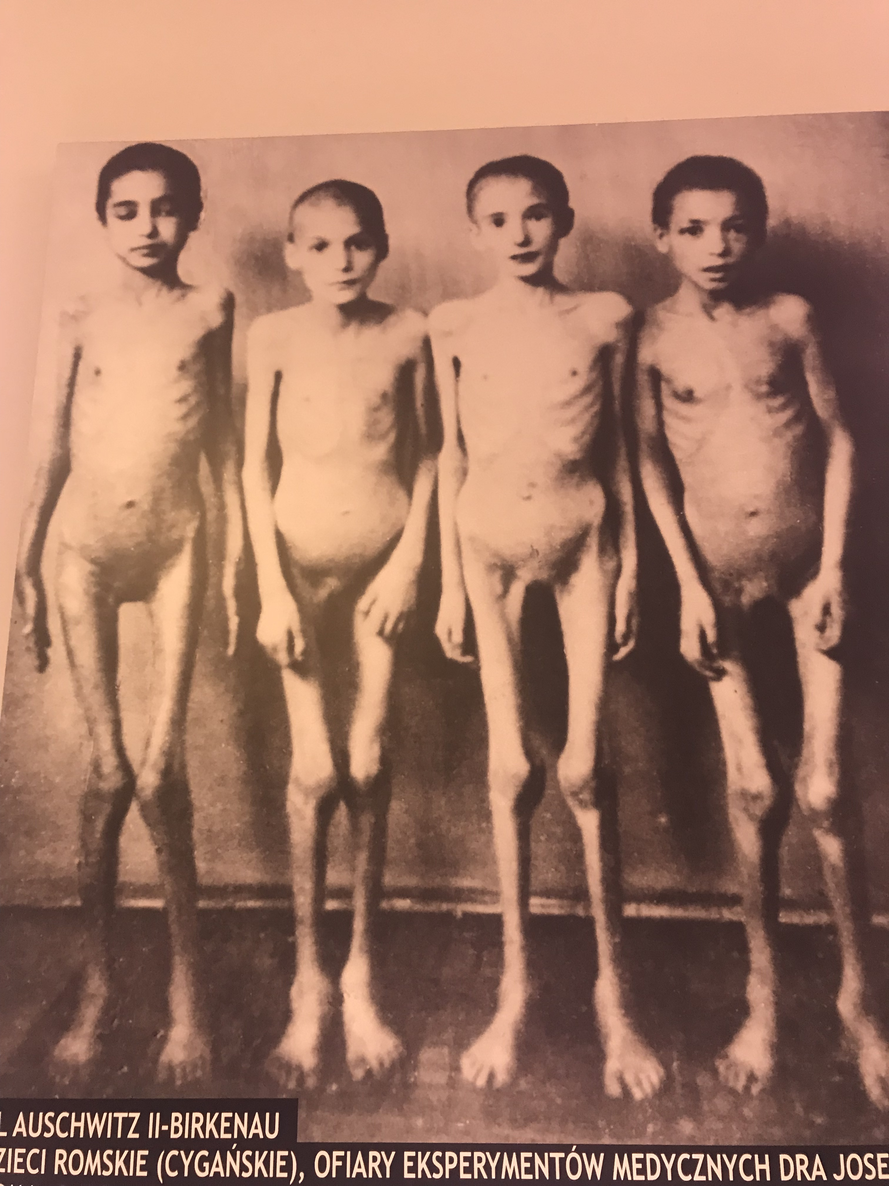

Slide 6
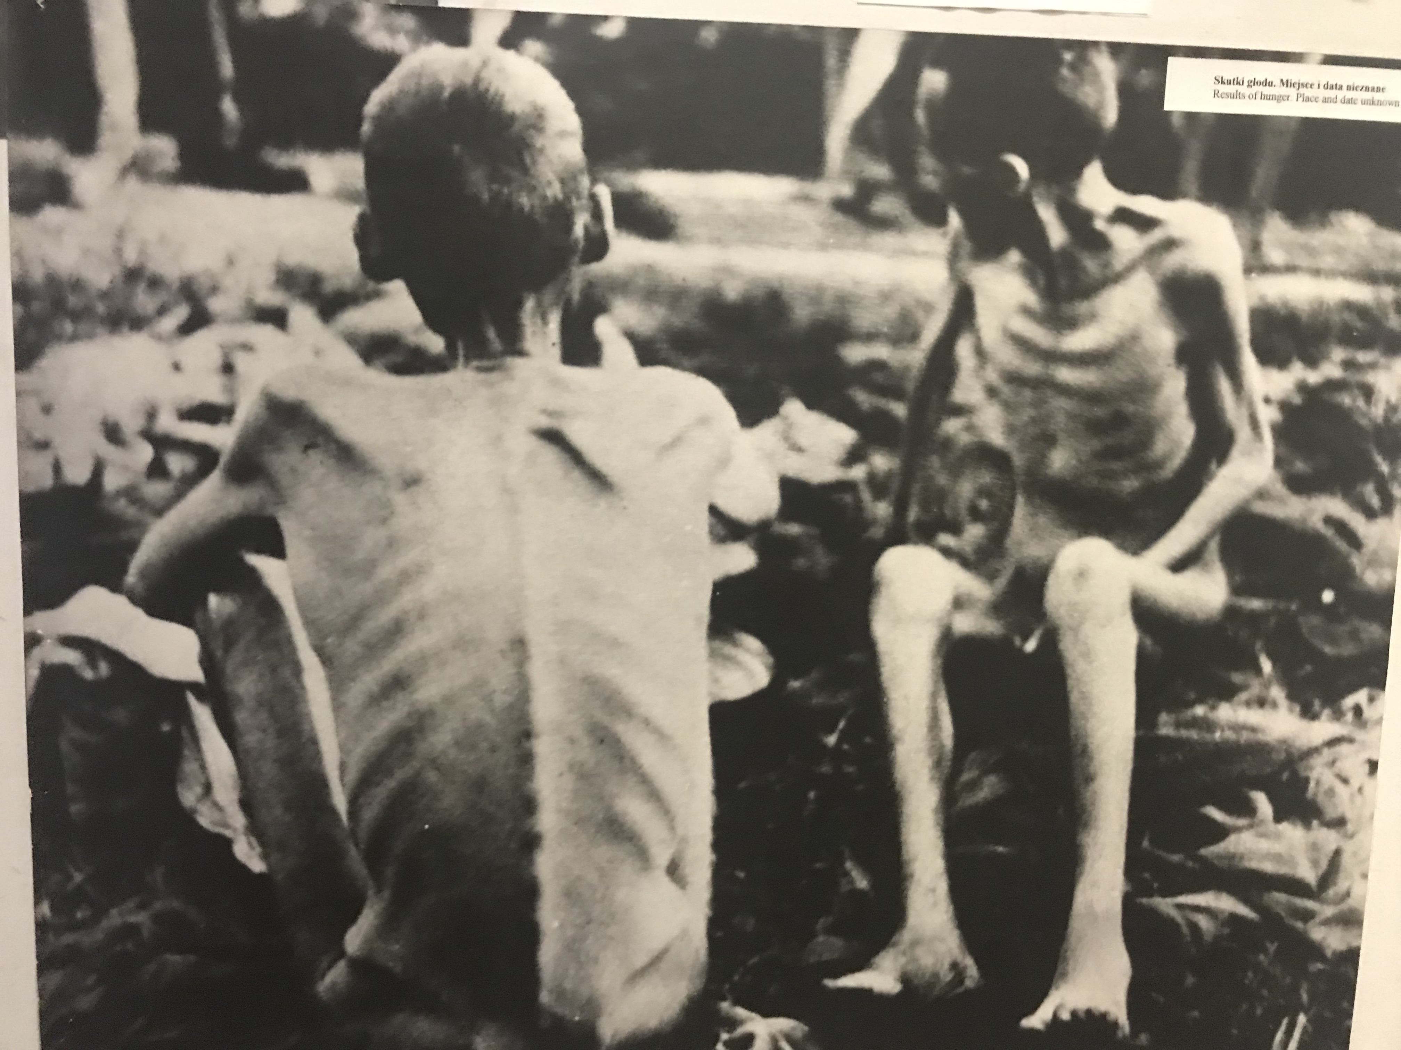

Slide 7
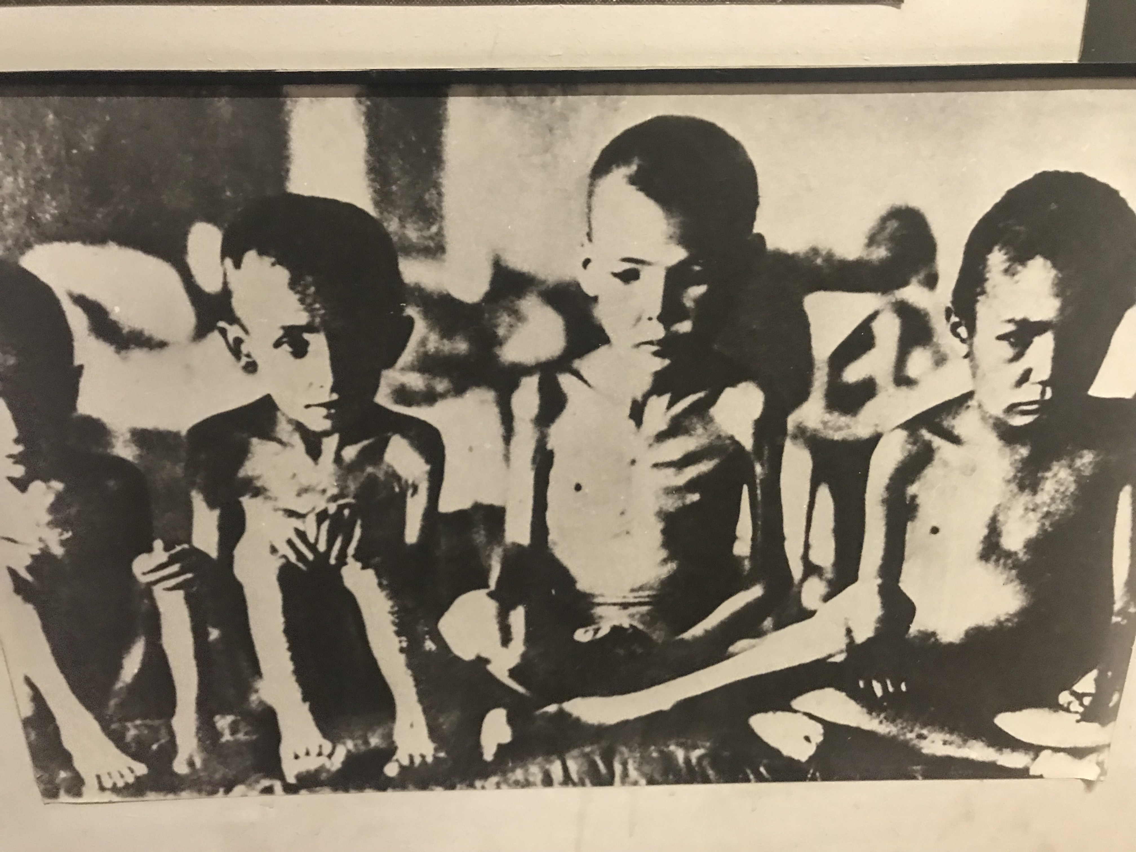

Slide 8
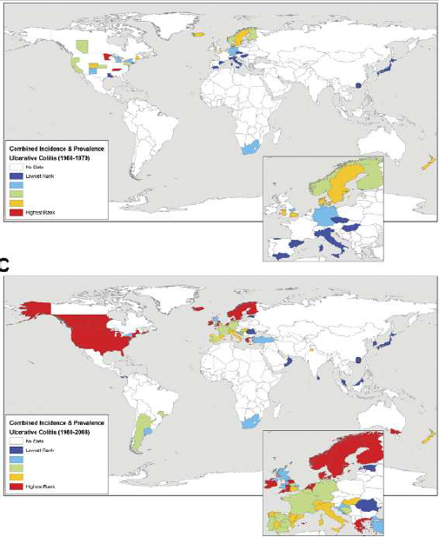
1960-1979
1980-2006

Slide 9
İBH’da malnutrisyonun boyutları
%23-%85 arası
  Crohn hastalığında %65-75
  Ülseratif kolitte %18-62
Aktif hastalıkta %70’lerde
Remisyonda %38
Mijac DD, et al. Eur J Intern Med 2010
Vadan R, et al. Clin Nutr 2011
Notes:
Malnutrition is highly prevalent in inflammatory bowel disease (IBD); present in up to 70% of patients with active disease and up to 38% of patients in remission[1-3].
Existing data suggest that malnutrition affects a large portion of patients with inflammatory bowel disease (IBD), estimated in 65–75% of patients with Crohn’s disease (CD) and in 18–62% of patients with ulcerative colitis (UC).

Slide 10
İBH & malnutrisyon
Hastane içi mortalite (OR 3.49, % CI: 2.89-4.23)
Hastanede yatış suresi (11.9 vs 5.8 gün, P < 0.00001)
Hastane maliyeti ($45,188 versus $20,295, P < 0.0001)
Düşük albümin düzeyi olan İBH hastası
  CAE, anastomoz kaçağı riskinde artış
  Anti-TNF başarısızlığında artış
Nguyen GC, et al. Inflamm Bowel Dis 2008
Telem DA et al. Arch Surg 2010
Notes:
Deans GT, Krukowski ZH, Irwin ST. Malignant obstruction of the left colon. Br J Surg. 1994; 81:1270–6. [PubMed: 7953385]
10. Van Hooft JE, Bemelman WA, Fockens P. [A study of the value of colonic stenting as a bridge to elective surgery for the management of acute left-sided malignant colonic obstruction: the STENT-IN 2 study]. Ned Tijdschr Geneeskd. 2007; 151:1249–51. [Article in Dutch]. [PubMed: 17583095]
11. Chang GJ, Kaiser AM, Mills S, Rafferty JF, Buei WD, Standards Practice Task Force of The American Society of Colon and Rectal Surgeons. Practice parameters for the management of colon cancer. Dis Colon Rectum. 2012; 55:831–43. [PubMed: 22810468]
12. Smithers BM, Theile DE, Cohen JR, Evans EB, Davis NC. Emergency

Slide 11
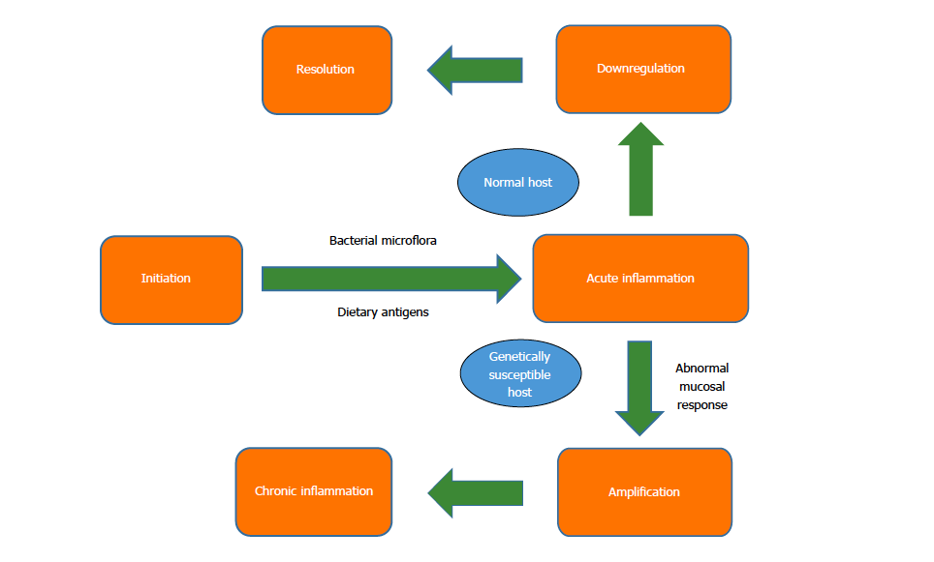
İBH & malnutrisyon

Slide 12
İBH & malnutrisyon
Azalmış nutrisyonel alım
Anoreksi, bulantı, ağrı, restriktif diyet
!!!!!
İnflamasyon
Artmış nutrisyonel gereksinim, infeksiyon, cerrahi
Artmış nutrisyonel kayıplar
Malabsorbsiyon, diare, kusma, fistül,
intestinal protein kayıpları
İBH’da malnutrisyon sebepleri
Medikasyon
Kortikosteroid
ilaç-nutrient etkileşimi
Cerrahi
Azalmış absorbtif kapasite
Kısa barsak sendromu
Malnutrisyon: Hospitalize hastalarda %40-70 & poliklinik hastalarda %20-50
Notes:
Overall survival if metastasis is resected

Slide 13
İlaca ait olumsuz etkiler
 | mekanizma | Kullanım sekli | Gastrointestinal yan etkiler
aminosalisilatlar | ? | Oral supp Enema | Karın ağrısı kramp
kortikosteroidler | Transaktivasyon ve nükleer proteinlerin transrepresyonu | Oral IV | Anoreksi Kilo kaybı Andominal ağrı Gastrit Ozefajit Parotein katabolizması Osteopeni Osteoproz
Azatioprin | Purin analoğu, DNA sentez inhbisyonu | Oral IV | Pankreatit Negatif nitrojen dengesi
Merkaptopurin | Prin sentez ve metobolizmasini etkileyerek DNA ve RNA fnskyonun degistirir | Oral | İntestinal ülseraysan
İnfliximab | Anti tumor necrosis factor antokoru | IV | Dispepesi Pankreatit intestinal perforasyon

Slide 14
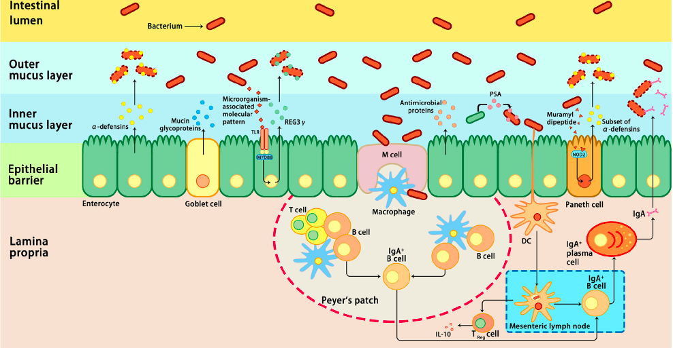
İntestinal mikrobiataya normal immun yanıt
Notes:
Host immune responses to intestinal microbiota. Several immune mechanisms work in concert to the intestinal microbiota and contribute to intestinal homeostasis. Goblet cells secret mucin glycoproteins, plasma cells secret IgA, and epithelial cells secrete antimicrobial proteins through toll-like receptors (TLRs), or nucleotide-binding oligomerization domain-containing protein 2 (NOD2)-dependent mechanisms. Dendritic cells (DCs) take up bacteria migrate to Peyer’s patches and mesenteric lymph nodes where B cells are differentiated into IgA-secreting plasma cells. In addition, sampling of polysaccharide A (PSA) from Bacteroides fragilis by intestinal DCs leads to induction of regulatory T (Treg), which is responsible for the production of IL-10. In addition, the antimicrobial proteins secreted by the host cells can modulate the composition of the microbiota. IL-10, interleukin 10; M cell, microfold cell; MYD88, myeloid differentiation primary-response protein 88; REG3γ, C-type lectin regenerating islet-derived protein 3γ.

Slide 15
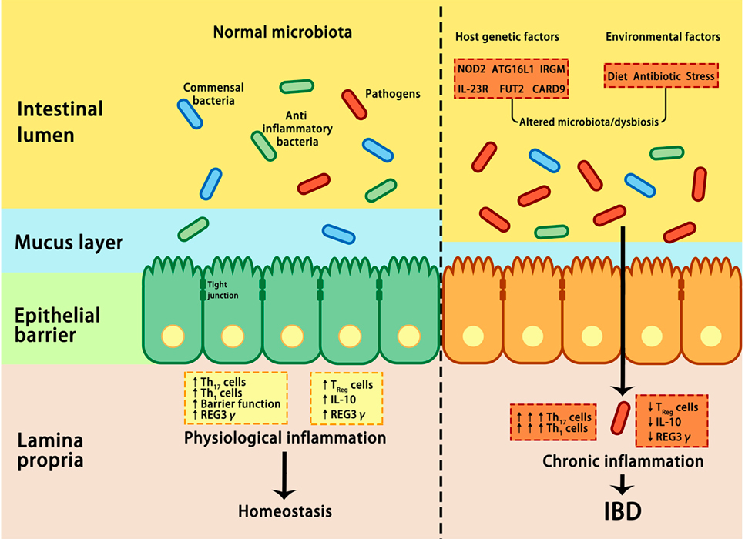
İBH & kronik inflamasyon
Notes:
nteractions between microbiota and host genetic and environmental factors contribute to the pathogenesis of IBD. Under healthy conditions (left panel), pathogens are suppressed by beneficial commensal bacteria through the induction of antimicrobial proteins, such as IL-10 and REG3γ, thus maintaining homeostasis. In IBD (right panel), a combination of genetic factors and environmental factors (such as stress, diet, and antibiotic) lead to dysbiosis, which in turn affects barrier integrity, innate, and adaptive immunity, resulting in uncontrolled chronic inflammation and hyper-activation of T helper 1 (Th1) and Th17 cells, increase in tight junction permeability, reduction in regulatory T (Treg) cells, and decrease in REG3γ and IL-10. ATG16L, autophagy-related 16-like; CARD9, caspase recruitment domain family member 9; FUT2, fucosyltransferase 2; IBD, inflammatory bowel disease; IL-10, interleukin 10; IRGM, immunity-related GTPase M; NOD2, nucleotide-binding oligomerization domain-containing protein 2; REG3γ, C-type lectin regenerating islet-derived protein 3γ.

Slide 16
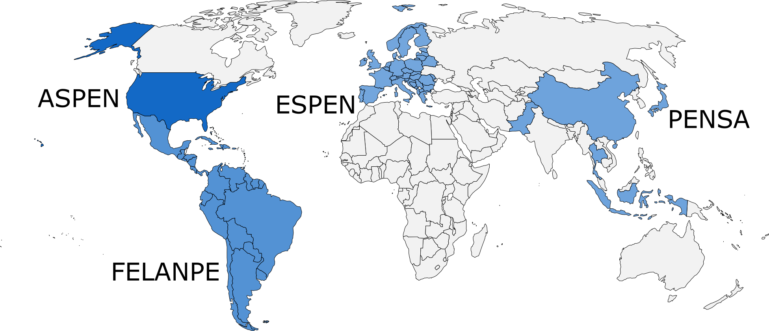
Global Liderlik Girişimi (GLIM) Nedir?
ASPEN + ESPEN + FELANPE + PENSA = GLIM
Dört büyük Beslenme otoritesinin bir araya gelmesi ile meydana getirdikleri bir konsensus grubudur
1. Cederholm, T el al. Clin Nutr. 2019 38(1)1-9

Slide 17
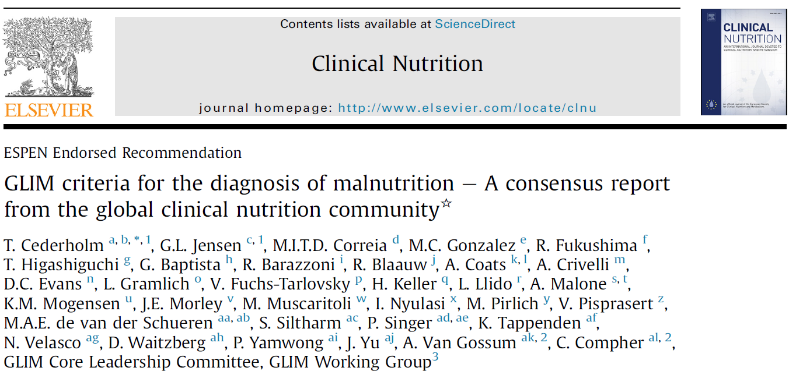
GLIM Malnütrisyon Kriterleri
Risk Tarama
Malnütrisyon için risk altında
Geçerli tarama araçları ile hastalar taranır
Tanısal
Değerlendirme
Değerlendirme kriterleri
Fenotipik
  İstemsiz kilo kaybı
  Düşük Vücut Kitle İndeksi
  Kas Kitlesinde Azalma
Etiyolojik
  Gıda alımı veya sindirimde azalma
  Hastalık yükü/inflamatuar durumda
GLIM Kriteleri ile birlikte
Kas kaybı ve inflamasyon
malnütrisyonun tanısına girdi
Tanı
Malnütrisyon tanısı için kriterleri karşılar
En az 1 Fenotipik kriter ve 1 Etiyolojik Kriter Gereklidir
Şiddet Derecesi
Malnütrisyonun ciddiyetini belirler
Ciddiyet Fenotipik kriterlere göre belirlenir
1. Cederholm, T el al. Clin Nutr. 2019 38(1)1-9

Slide 18
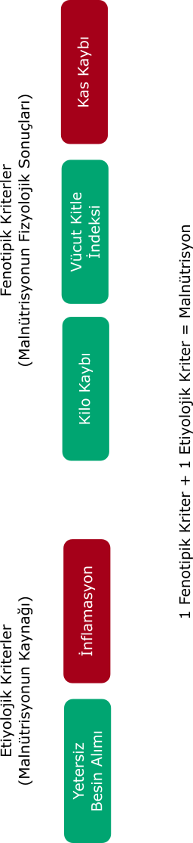
GLIM Malnütrisyon Kriterleri
GLIM Kriteleri ile birlikte Kas kaybı ve inflamasyon malnütrisyonun tanısına girdi
1. Cederholm, T el al. Clin Nutr. 2019 38(1)1-9

Slide 19
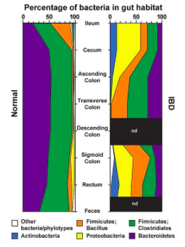
Dysbiozis & IBH
Notes:
Barsakta bulunuan 100 trilyon değişik mikrobial organizma (makteri, virüs, parazir mantar) insan vuucndandaki hucerelerin totalinden 10 fazladır
1000 adet turun GIS temsil ettiği bilinmektedir ve bunlarin cogunlugunu
Firmicutes, Bacteroidetes, Proteobacteria, and Actinobacteria oluşturmaktadır. Bunlarin içinde Firmicutes (Gram-positive) and Bacteroidetes (Gram-negative) are the predominant phyla across all mammalian species, accounting for over 90% of all intestinal bacteria (12, 23–25

Slide 20
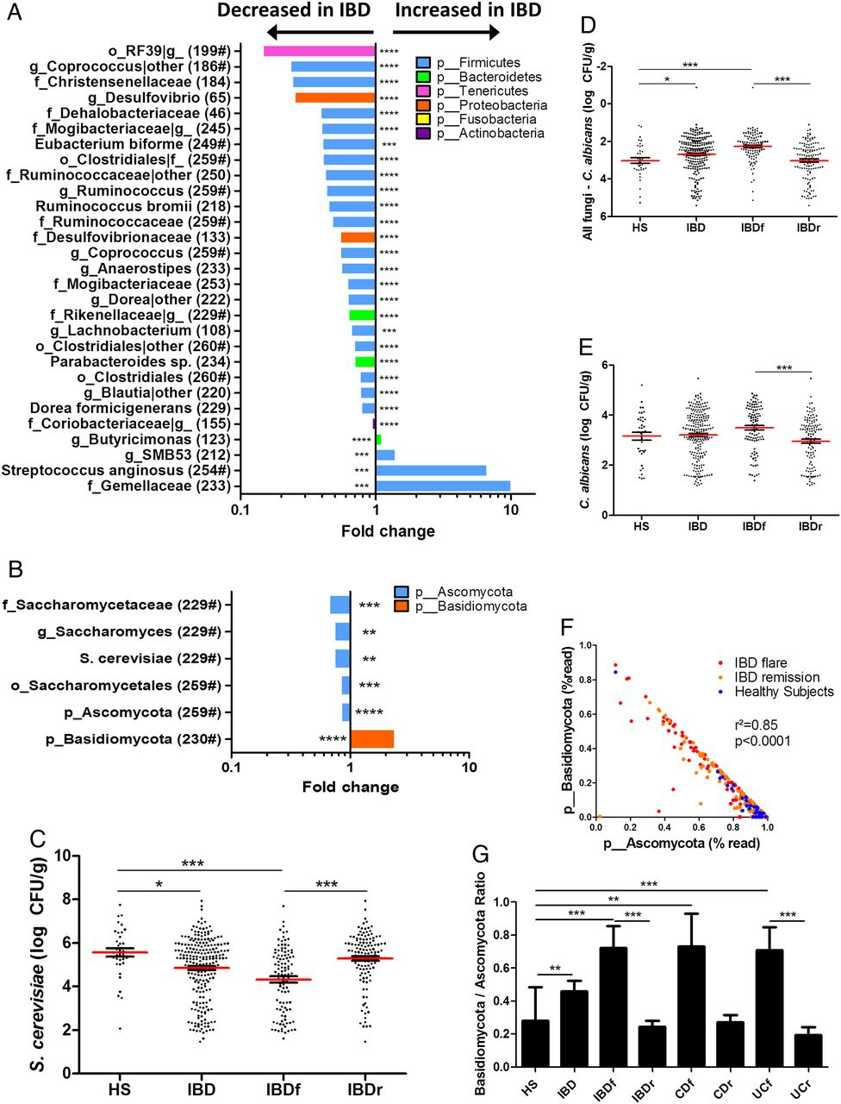

Harry Sokol et al. Gut 2017;66:1039-1048
Notes:
Bacterial and fungal taxa associated with IBD. (A and B) Differences in abundance are shown for the bacterial and fungal taxa detected using a multivariate statistical approach (see ‘Material and Methods’). The fold change for each taxon was calculated by dividing the mean abundance in the cases by that of the controls. The number of subjects that have any presence (>0) of the indicated taxon is indicated in brackets, and taxon with a mean abundance of >0.5% in at least one of the groups is indicated with ‘#’. (C) Absolute Saccharomyces cerevisiae abundance in the faecal microbiota quantified using qRT-PCR (mean±SEM). (D) Relative proportion of Candida albicans calculated by subtracting the log number of C. albicans from the log number of all fungi. (E) Absolute C. albicans abundance in the faecal microbiota quantified using qRT-PCR (mean±SEM). (F) Basidiomycota/Ascomycota relative abundance ratio in the various groups studied (Kruskal–Wallis test with Dunn's multiple comparison test, *p<0.05; **p<0.01; ***p<0.001; ****p<0.0001). CD, Crohn's disease; HS, healthy subjects.

Slide 21
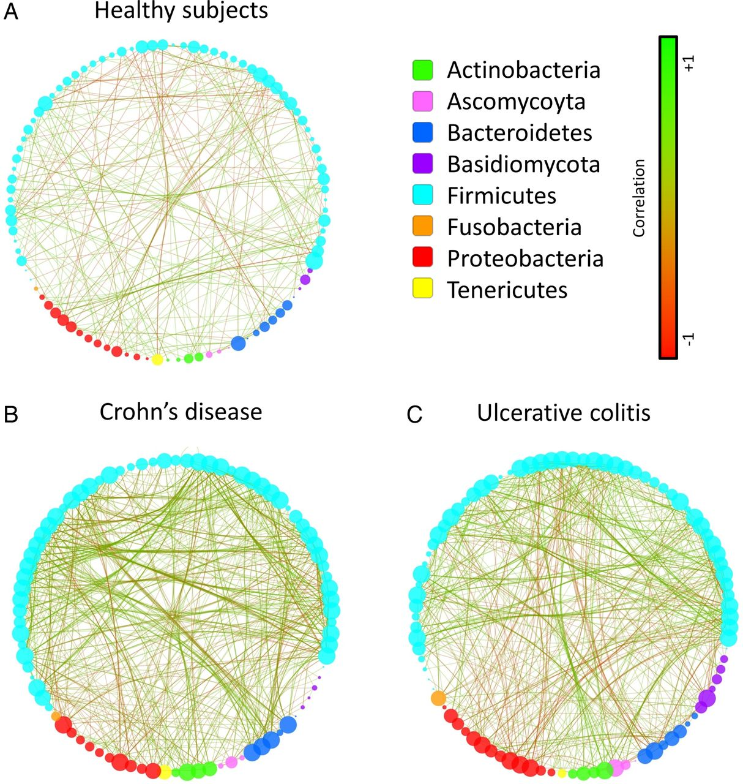
Imbalance trans-kingdom network in IBD. Correlation network in healthy subjects (A), Crohn's disease (B) and UC (C) generated using Cytoscape.
Harry Sokol et al. Gut 2017;66:1039-1048
Notes:
Imbalance trans-kingdom network in IBD. Correlation network in healthy subjects (A), Crohn's disease (B) and UC (C) generated using Cytoscape. Each circle (node) represents a microbial genus, its colour represents the bacterial or fungal phylum it belongs to and its size represents the number of direct edges that it has. The edge colour indicates the magnitude of the distance correlation; green indicates positive correlation and red indicates negative correlation (determined using spearman test). Statistical significance was determined for all pairwise comparisons; only significant correlations (p value <0.05 after false discovery rate correction) are displayed.

Slide 22
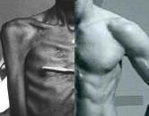
İBH & Sarkopeni

Slide 23
İBH & Sarkopeni
Malnutrisyon. immobolite, düşük protein sentezi, artmış proteoliz
Kronik enflamasyon sonucu kasta protein degradasyonu ve myofibriler protein yıkım sonucu kas hacmi ve fonksiyonunda azalma
İnsulin/GH/IGF 1
IBH’da IGF 1 düzeylerinde belirgin azalma
Notes:
Principal
mechanisms involved in genesis of sarcopenia are malnutrition,
immobility, low protein synthesis, and increased
proteolysis [28, 29].
In chronic inflammation, a shift of proteinturnover poised toward protein degradation with subsequent reduction of myofibrillar proteins can be observed, resulting in loss ofmusclemass and impairedmuscular contraction. Iinflammatory chronic diseases, muscle protein degradation seems to depend on a coordinated network of signaling pathways regulated by hormones and cytokines, which reduce synthesis and increase protein degradation
Current evidences indicate that several cellular pathways, involved in cellular growth, are deregulated during chronic inflammatory disorders, in particular the ubiquitin proteasome and the autophagy pathways. The most important pathway involved in muscle growth is the insulin/GH/IGF1 system. Normally, circulating GH binds to transmembrane GH receptors, activating the synthesis of IGF1 in liver and other tissues a bone andmuscles. In bones, IGF1 stimulates the proliferation of chondrocytes and osteoblasts in the epiphysis of long bones, resulting in linear growth,while inmuscular cells IGF1 enhances protein synthesis via P13K/AKT phosphorylation with activation of mTOR system and reduction of activation of ubiquitin ligands [38].
In IBD, as in chronic inflammatory
conditions, a significant reduction in plasma and muscle
IGF1 can be seen in response to the elevated concentrations
of TNF-alpha and IL-6, cytokines that cause GH resistance
in liver and muscles, inducing downregulation of mTOR
pathway with activation of ubiquitin ligands and expression
of enzymes involved in protein degradation, in particular
atrogin-1, MuRF1, and MUSA1 [39–41].

Slide 24
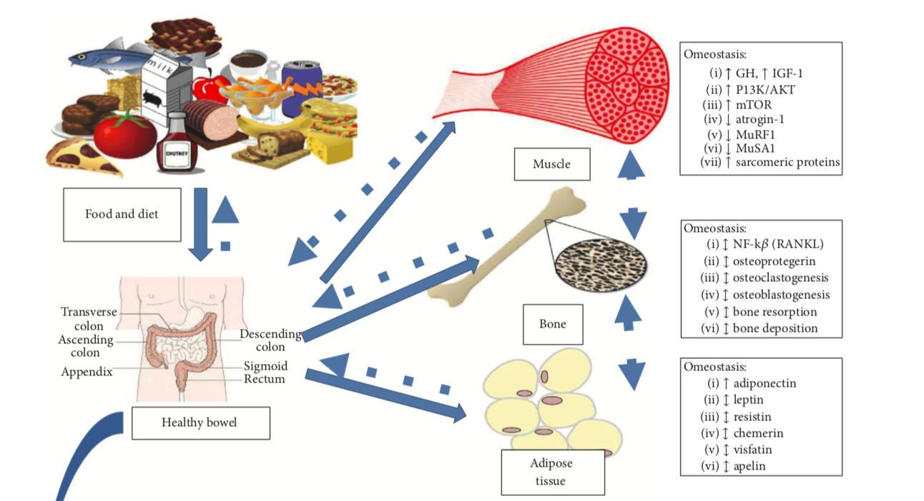
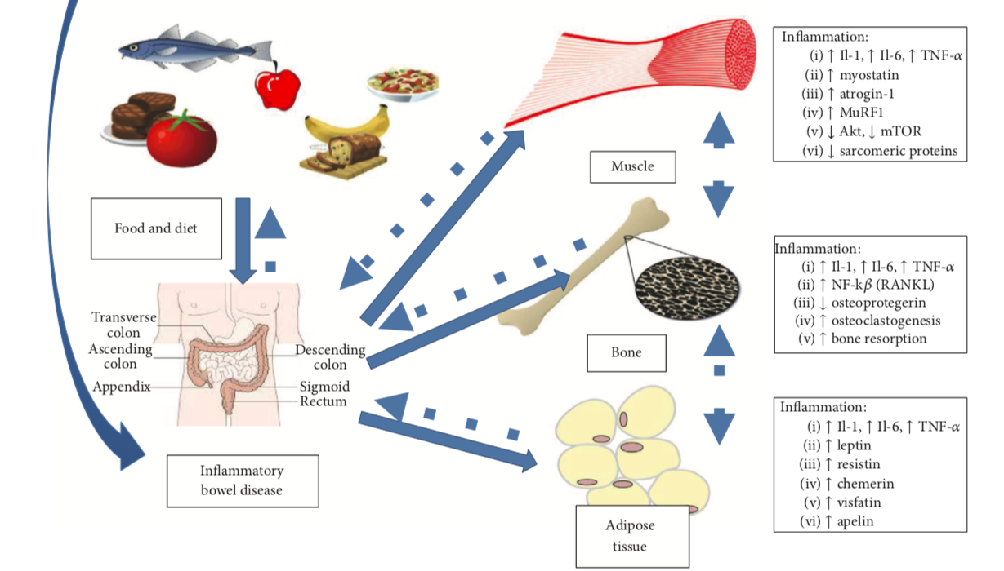

Slide 25
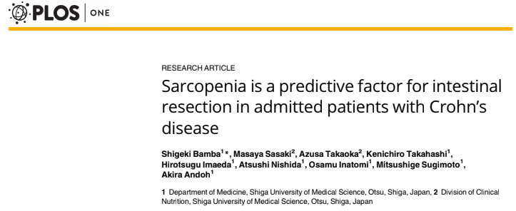
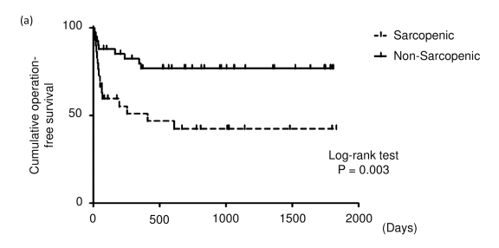
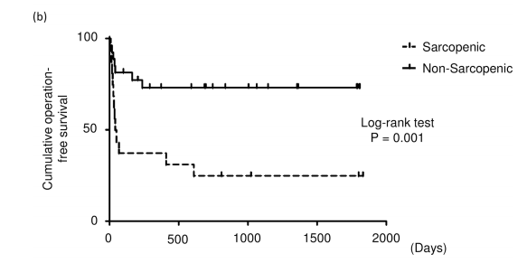
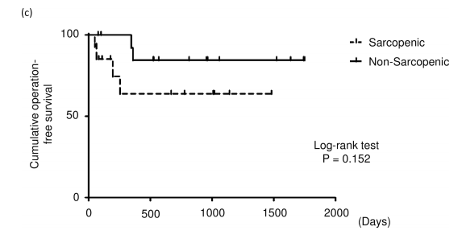
Crohn hastalığı
Ülseratif kolit
İBH

Slide 26
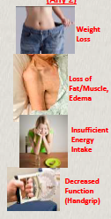
İBH & malnutrisyon tanısı neden zor?
Malnutrisyon kompleks bir hastalık
Spesifik antropometrik/lab ölçümü yok
Klinik vizitlerin süresi ?
Altyapı: nutrisyon takımı
Mueller C et al. JPEN 2011
Notes:
Deans GT, Krukowski ZH, Irwin ST. Malignant obstruction of the left colon. Br J Surg. 1994; 81:1270–6. [PubMed: 7953385]
10. Van Hooft JE, Bemelman WA, Fockens P. [A study of the value of colonic stenting as a bridge to elective surgery for the management of acute left-sided malignant colonic obstruction: the STENT-IN 2 study]. Ned Tijdschr Geneeskd. 2007; 151:1249–51. [Article in Dutch]. [PubMed: 17583095]
11. Chang GJ, Kaiser AM, Mills S, Rafferty JF, Buei WD, Standards Practice Task Force of The American Society of Colon and Rectal Surgeons. Practice parameters for the management of colon cancer. Dis Colon Rectum. 2012; 55:831–43. [PubMed: 22810468]
12. Smithers BM, Theile DE, Cohen JR, Evans EB, Davis NC. Emergency

Slide 27
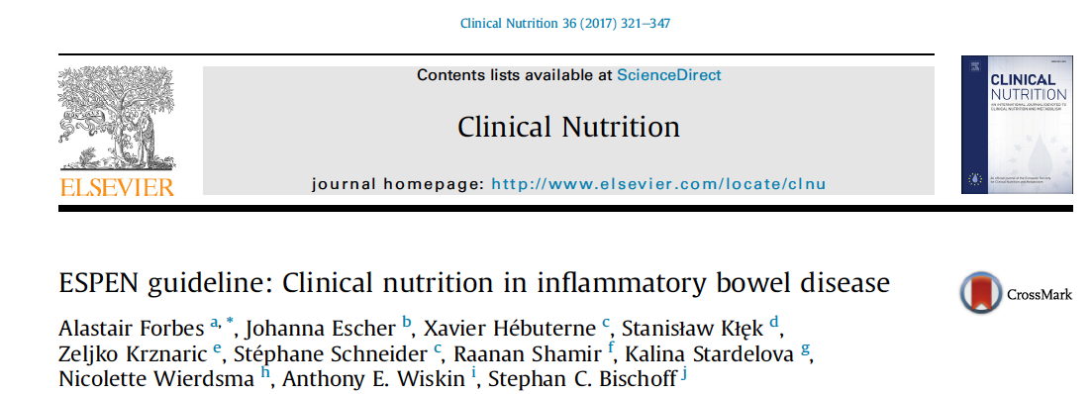
İBH’da nutrisyonel değerlendirme
1. basamak: Tüm İBH hastalarını nutrisyon açısından taranmalıdır
Nutrisyonel açıdan iyi
Malnutre
Risk altında
2. basamak: nutrisyonel değerlendirme
Metabolik, nutrisyonel ve fonksiyonel açıdan cerrah, diyetisyen ve nutrisyon hemşiresi tarafından detaylı değerlendirme
3. basamak: nutrisyonel müdahale
Notes:
Patients with IBD are at risk and therefore should be screened
for malnutrition at the time of diagnosis and thereafter on a
regular basis.
Grade of recommendation GPP e Strong consensus (96%
agreement)
Recommendation 3 B:
Documented malnutrition in patients with IBD should be
treated appropriately, because it worsens the prognosis, complication
rates, mortality and quality of life.
Grade of recommendation GPP e Strong consensus (96%
agreement)

Slide 28
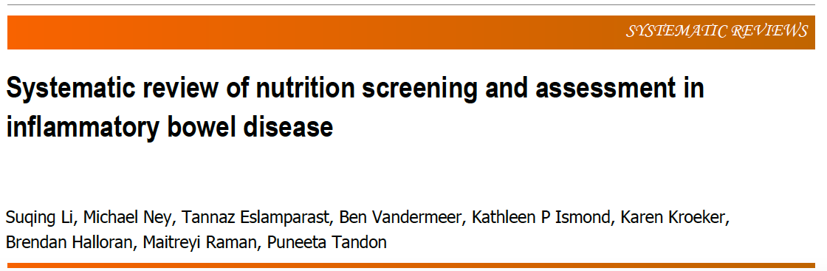
İBH’da nutrisyonel değerlendirme
16 çalışma, 1618 hasta
  Crohn hastalığı: %72
  Ülseratif kolit: %28
Notes:
Of 16 studies and 1618 patients were included, 72% Crohn’s disease and 28%
ulcerative colitis.

Slide 29
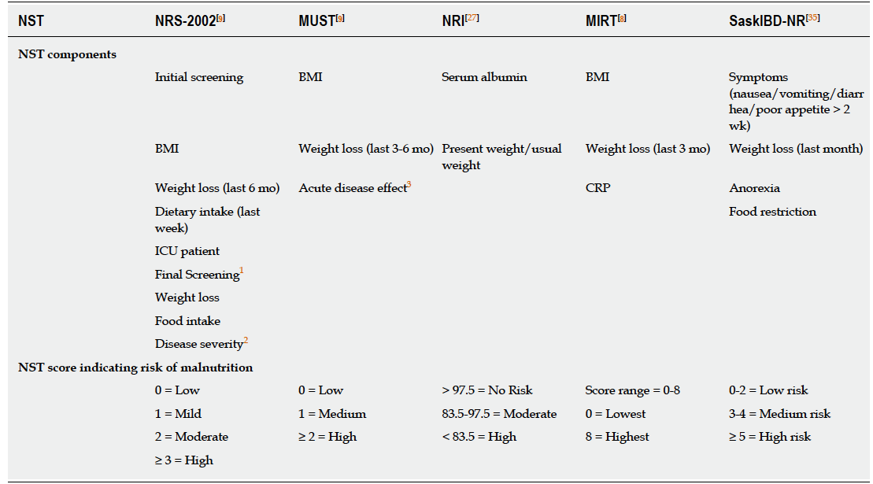
İBH’da nutrisyonel tarama

Slide 30
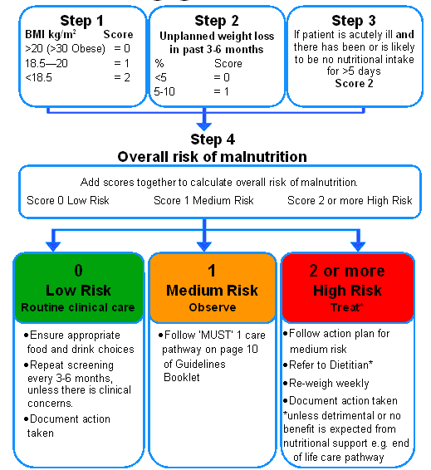
İBH’da nutrisyonel tarama & MUST

Slide 31
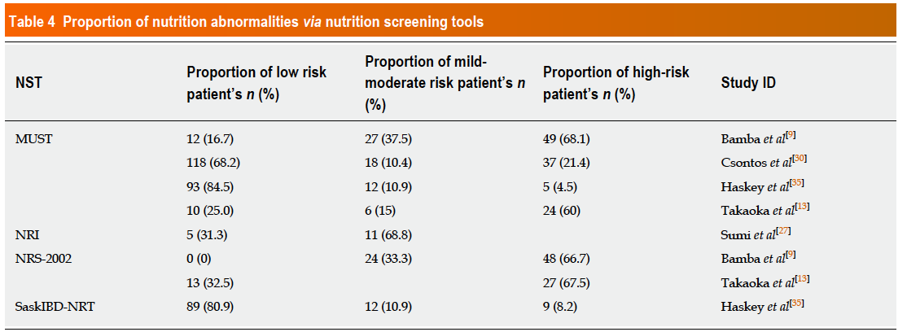
İBH’da nutrisyonel tarama
Notes:
Five studies utilized various NSTs (MUST, NRI, NRS-2002, and SaskIBD-NRT) to
categorize patients ordinally into low, moderate and high nutrition risk
categories[9,13,27,30,35]. The most commonly utilized NST was the MUST (4/5 studies)
showing 28.0% (n = 115) to be at high nutrition risk (MUST ≥ 2) across a composite of
inpatient/outpatient studies[9,13,30,35]. Of the two inpatient studies, both utilizing the
NRS-2002, 67.0% (n = 75) of patients were found to be at high nutrition risk (NRS-2002
≥ 3)[9,13]. Of the three outpatient studies, 29.1% (n = 87) of patients were found to have
at least a mild/moderate degree of nutrition risk via MUST (score ≥ 1), NRI (score ≥
97.5) and SaskIBD-NRT (score ≥ 3)[27,30,35] (Table 4).

Slide 32
İBH’da nutrisyonel değerlendirme
Tarama sonucunda malnutre yada risk altında olduğu tespit edilen hastalara nutrisyonel değerlendirme:
  Öykü
  FM
  Diyet kayıtları, VKI, antropometri
  SGA
  Laboratuvar
Notes:
Patients identified as malnourished or at‐risk in the nutrition screening
should have a nutritional assessment:
– History
– Clinical exam
– Food record, BMI, Anthropometry
– SGA
– Laboratory values

Slide 33
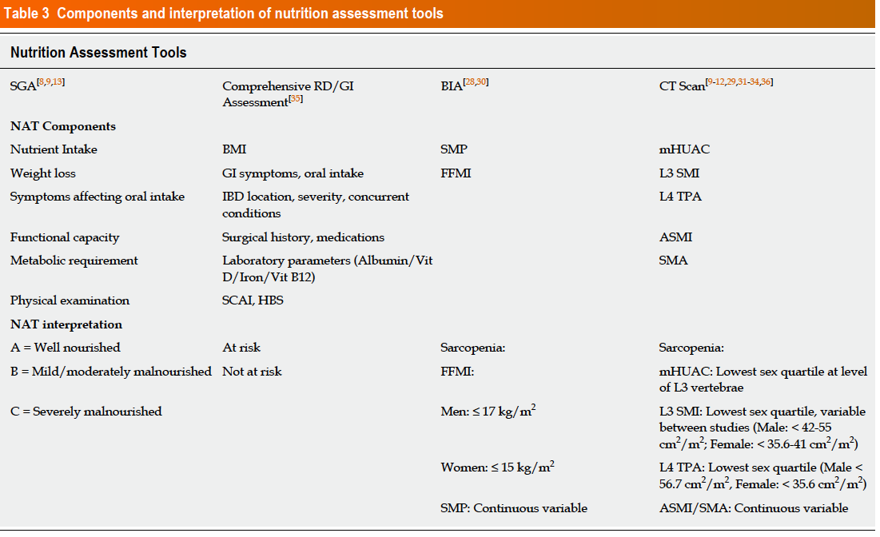
İBH’da nutrisyonel değerlendirme

Slide 34
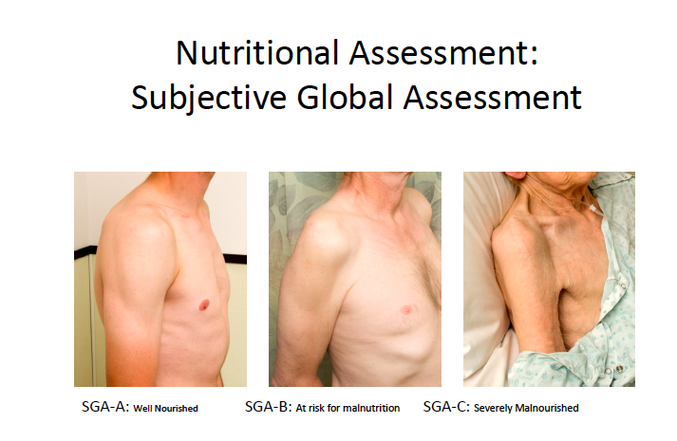
Subjektif Global Değerlendirme
-Kilo kaybı ve nutrient alımında sorun yok
-Nutrisyonu etkileyen GI semptom yokluğu
-Normal fonksiyonel durum
-Cilt altı yağ dokusu ve kas kitlesi normal
-Malnutrisyon bulgularında iyileşme
-Son 6 ay içinde %5-10 kilo kaybı
oral alımda mutlak azalma
-Nutrisyonu etkileyen GI semptomların varlığı
-Fonksiyonel açıdan ılımlı düzeyde bozulma
-Cilt altı ılımlı yağ dokusu ve kas kitlesinde ılımlı azalma
-Son 6 ay içinde %10’dan fazla kilo kaybı
-Oral alımda mutlak azalma
-Nutrisyonu etkileyen şiddetli GI semptomların varlığı
-Ciddi fonksiyonel bozukluk
-Cilt altı ılımlı yağ dokusu ve kas kitlesinde belirgin azalma
A
B
c

Slide 35
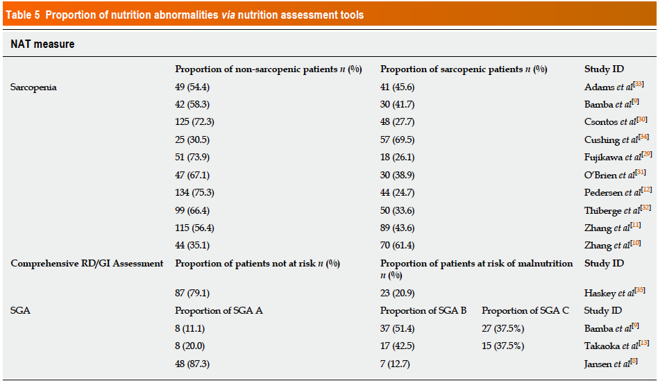
İBH’da nutrisyonel değerlendirme
Notes:
Ten studies evaluated the presence of sarcopenia in their respective populations, with a total prevalence of 39.5% (n = 477) across all studies[9-12,29-34]. Three studies utilized the SGA in categorizing patients into well-nourished (SGA-A), mild/ moderately malnourished (SGA-B) and severely malnourished (SGA-C) with two of the studies based on an inpatient IBD population. The total proportion of patients diagnosed with some degree of malnutrition based on SGA (SGA B/C) was 61.7% (n= 103)[8,9,13] (Table 5).

Slide 36
İBH aktivitesinde nutrisyon
Aktiviteye sebep olan net bir gıda kategorisi yok
Laktoz kısıtlaması ?
Yetişkin grupta aktif hastalıkta enteral nutrisyon indüksiyon tedavisinin bir parçası değil (Glukokortikoidlere kıyasla)
Standart enteral nutrisyon (polimerik vs elemental, omega-3 yag asidi içeren, yüksek protein icergi olan)

Slide 37
İBH & Remisyonda nutrisyon
Diyet kısıtlamasına gerek yok
Eliminasyon diyeti
Suplemental enteral nutrisyon:
  Kullanılmalı ancak remisyonun primer idame tedavisi olarak yeri yok
Fiber kullanımı:
  14 gr/1000 kalori
  strikturizan paternde önerilmemekte
  Remisyonun sağlanmasında etkili olabilir

Slide 38
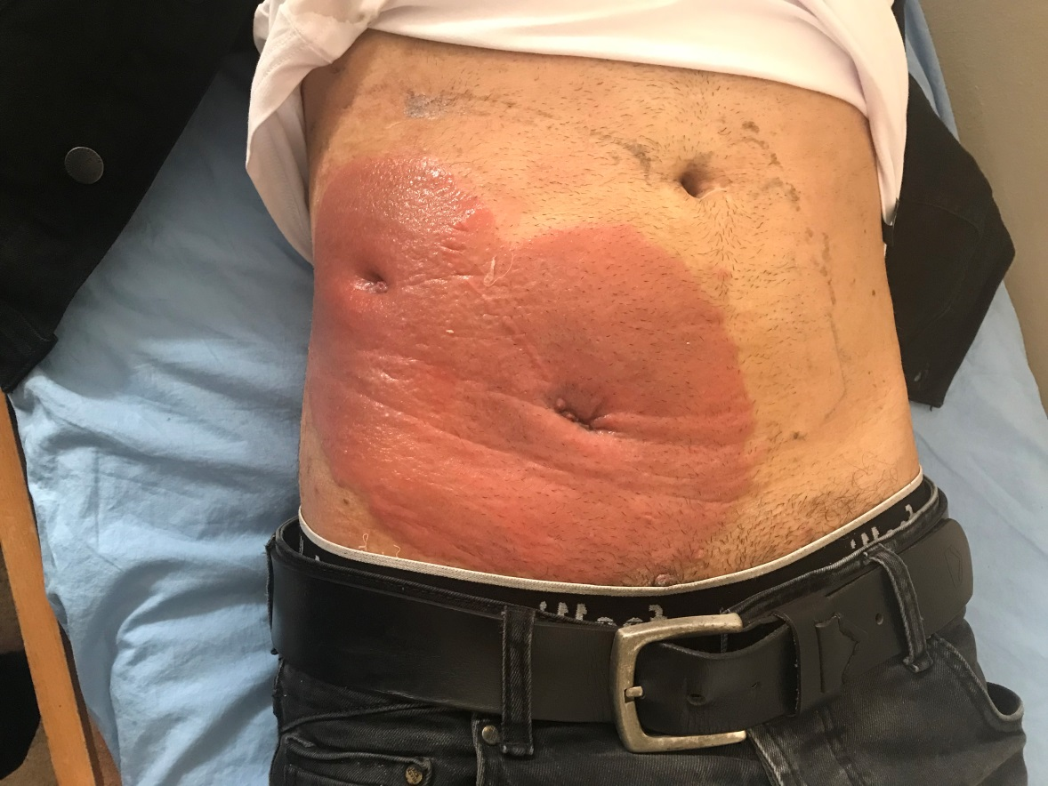

Slide 39
-Bu hastaya nasıl bir nütrisyonel destek planlarsınız?
  Nütrisyonel destek için özel bir çaba gerekmez, periferden sıvı-elektrolit replasmanı yeterlidir
  Periferik PN (parenteral nütrisyon) başlarım
  Santral PN (TPN) başlarım
  NG tüple EN (enteral nütrisyon) başlarım
  EN + PN birlikte başlarım
  Mikronutruientler ?
  Eser element ?
  Elemental vs polimerik formüller

Slide 40
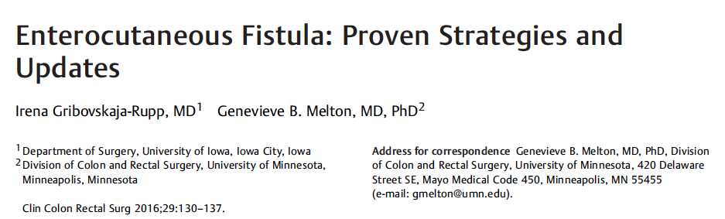
S N A P
Sepsis tedavisi
Nutrisyon
Anatominin tanımlanması
Prosedür
Mortalitenin %77 sebebi
Perkutan drenaj?
Antibiyotik
Kaynak kontrolü
  Anastomoz?
Entral vs PN
Mikrobesinler
Yara bakımı
Bilgisayarli Tomografi
Fistulografi
MR enterografi
Hangi operatif strateji
Hangi nutrisyonel destek
Devamlılığı sağlama
Zamanlama
İlk 10 gün ya da 6. haftadan daha geç Mortalite %10
Ara dönemde
Mortalite %21

Slide 41
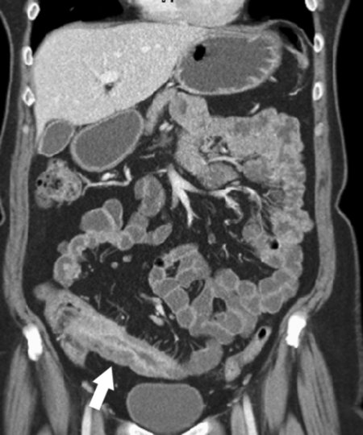
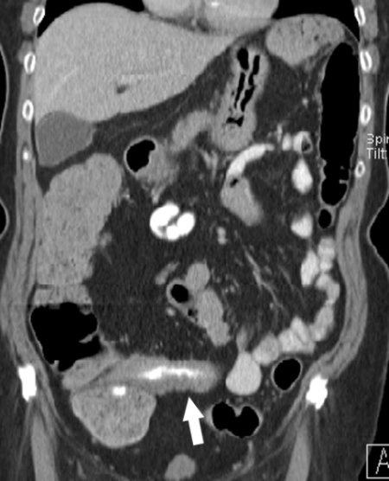

Slide 42
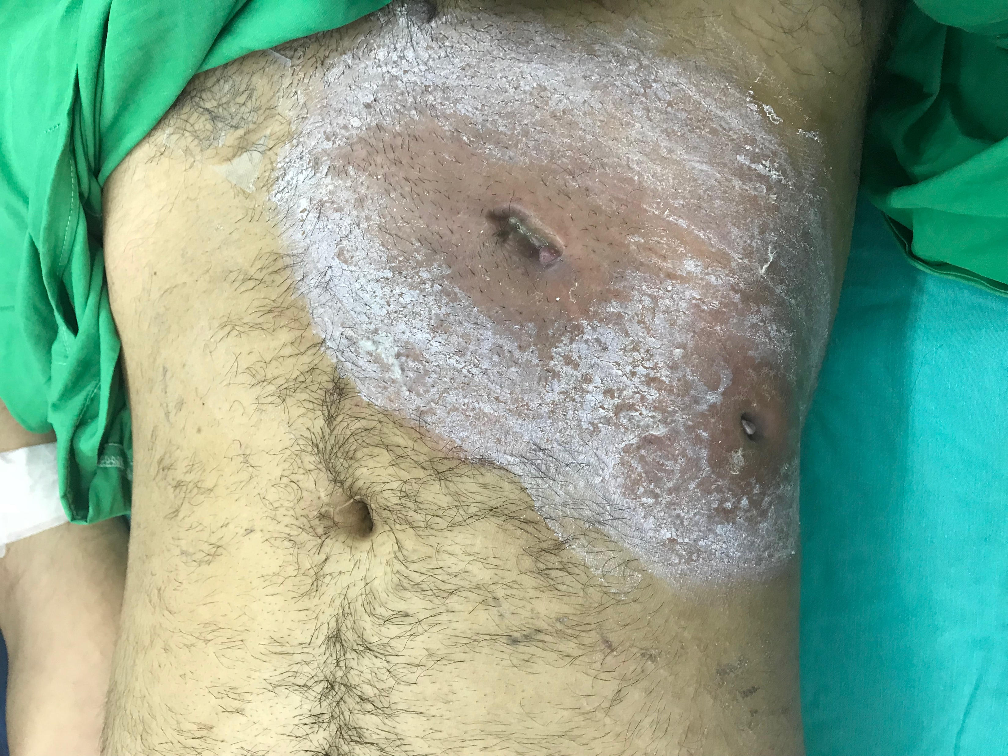
Klinik Seyir
Hastada septik ve enflamatuar markırlar ve selülit bulguları gerileyene kadar 6 gün TPN tercih edildi.
Klinik seyrinde ve fizik muayene bulgularında bir miktar düzeleme olan hastada nutrisyonel desteğe kombine polimerik EN + PN ile devam edildi.

Slide 43
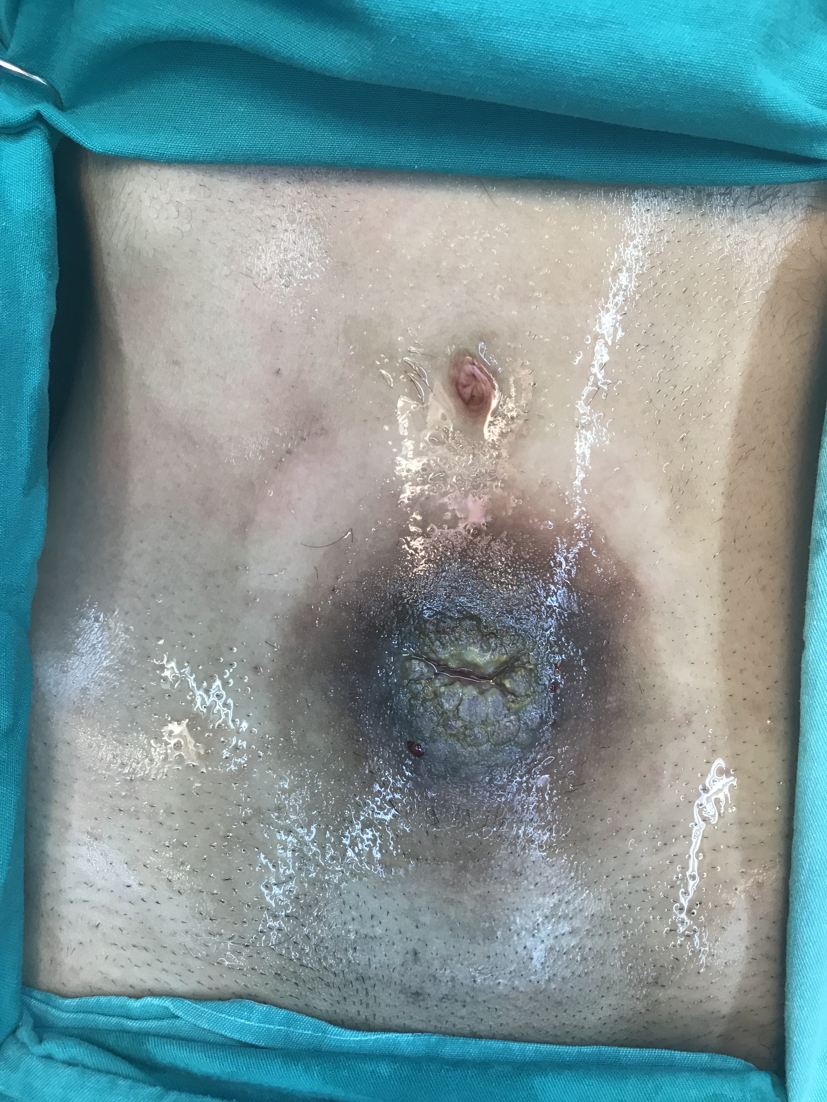

Slide 44
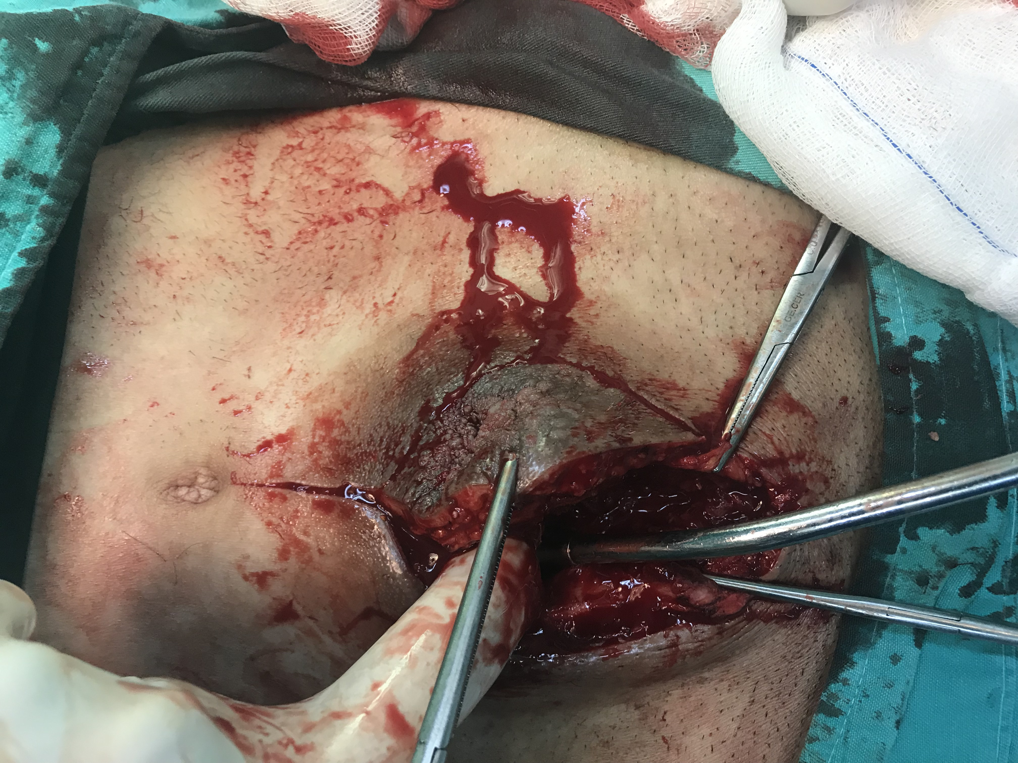

Slide 45
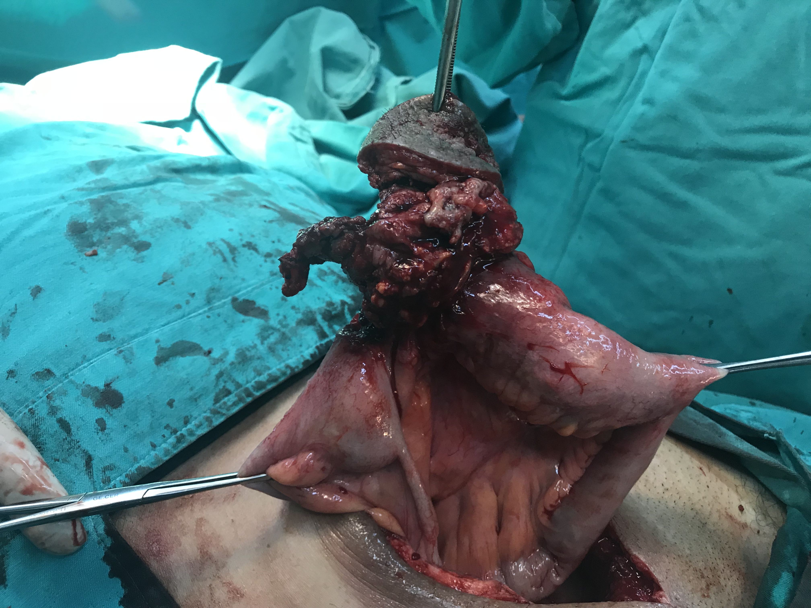

Slide 46
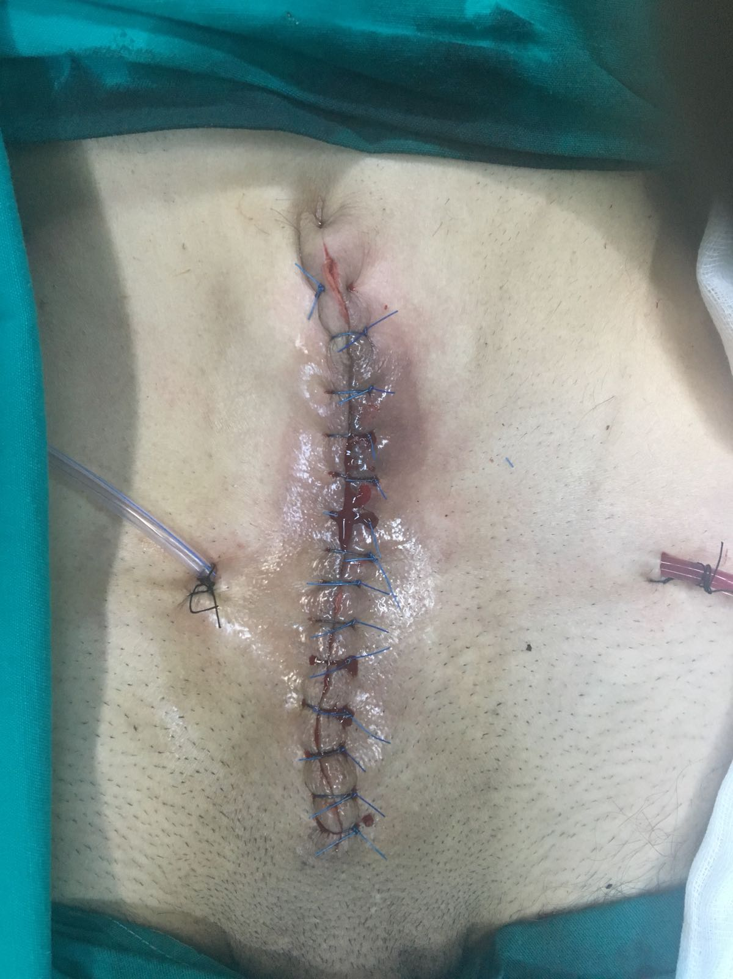

Slide 47
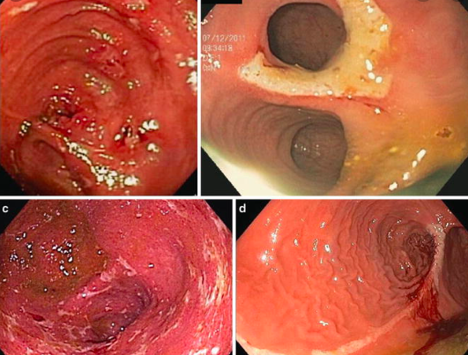
Poşit
Notes:
For patients with ulcerative colitis, some probiotics (eg, E. coli Nissle 1917, VSL #3) show promise, but no preparations have been validated for clinical use. For patients with CD, the available data do not support clinical effectiveness of probiotic therapy for either induction or maintenance of remission. Probiotics are living, nonpathogenic micro-organisms that, when ingested, are believed to have the potential to exert a positive influence on host health and physiology. The use of probiotics in the management of patients with IBD, including those with pouchitis, is discussed separately. (See "Probiotics for gastrointestinal diseases"and "Pouchitis: Management", section on 'Probiotics'.)

Slide 48
Poşit
İnflamasyon:
  Barsak ph’da artış
  Fekal butirat düzeyinde azalma (sindirime dirençli nişasta)
  Fekal florada degisim
  Safra asit konsantrasyonunda artış
inulin-----kısa zincirli yağ asitleri
  Endoskopik ve klinik iyileşme
Probiyotik: VSL#3
  Streptococcus salivarius, L casei, Lactobacillus plantarum, Lactobacillus acidophilus, Lactobacillus delbrueckii, Bifidobacterium longum, Bifidobacterium infantis, and Bifidobacterium breve
Notes:
The inflammation observed in pouchitis is accompanied by increased bowel pH,
decreased fecal butyrate, altered fecal flora, and increased concentrations of bile
acids. Inulin, a dietary fiber, is fermented to short-chain fatty acids and reduces bowel
pH. One study investigated the effects of enteral inulin supplementation on inflammation
of the ileal reservoir.46 After 3 weeks of supplementation, inulin increased butyrate
levels, and decreased pH, Bacteroides fragilis levels, and bile acid levels in the pouch
lumen. This finding was accompanied by endoscopically and histologically reduced
inflammation in the ileal reservoir.46 Alles and colleagues44 evaluated the extent to
which pouches ferment undigested carbohydrates. The ability of the ileal pouch to
ferment dietary carbohydrates is associated with the absence of pouchitis. It is interesting
that resistant starches are fermented into butyrate, the primary fuel of the
colonic mucosa. Moreover, negative correlation between butyrate levels and pouch
mucosa villous atrophy has been previously established.44 These findings provide
sufficient rationale to study the ingestion of resistant starches in IPAA patients to either
prevent or treat pouchitis.44

Slide 49
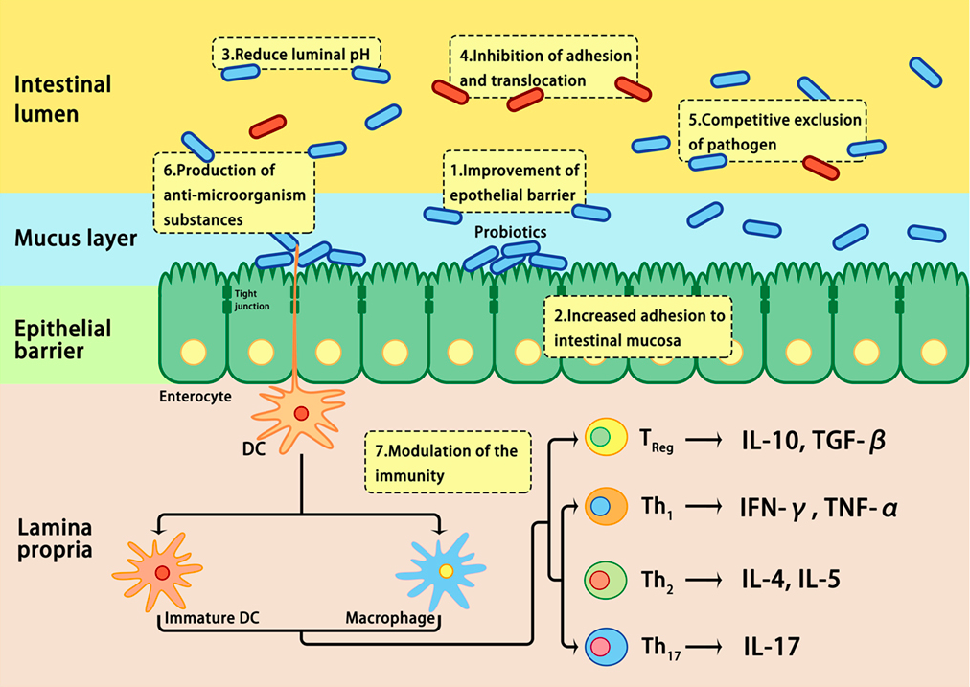
Probiyotik etki mekanizması
Notes:
nteractions between microbiota and host genetic and environmental factors contribute to the pathogenesis of IBD. Under healthy conditions (left panel), pathogens are suppressed by beneficial commensal bacteria through the induction of antimicrobial proteins, such as IL-10 and REG3γ, thus maintaining homeostasis. In IBD (right panel), a combination of genetic factors and environmental factors (such as stress, diet, and antibiotic) lead to dysbiosis, which in turn affects barrier integrity, innate, and adaptive immunity, resulting in uncontrolled chronic inflammation and hyper-activation of T helper 1 (Th1) and Th17 cells, increase in tight junction permeability, reduction in regulatory T (Treg) cells, and decrease in REG3γ and IL-10. ATG16L, autophagy-related 16-like; CARD9, caspase recruitment domain family member 9; FUT2, fucosyltransferase 2; IBD, inflammatory bowel disease; IL-10, interleukin 10; IRGM, immunity-related GTPase M; NOD2, nucleotide-binding oligomerization domain-containing protein 2; REG3γ, C-type lectin regenerating islet-derived protein 3γ.

Slide 50
Probiyotik
Ülsertatif kolit: bazı probiyotikler (E. coli Nissle 1917) klinik kullanım için uygun
Crohn: destekleyen data yok
Notes:
For patients with ulcerative colitis, some probiotics (eg, E. coli Nissle 1917, VSL #3) show promise, but no preparations have been validated for clinical use. For patients with CD, the available data do not support clinical effectiveness of probiotic therapy for either induction or maintenance of remission. Probiotics are living, nonpathogenic micro-organisms that, when ingested, are believed to have the potential to exert a positive influence on host health and physiology. The use of probiotics in the management of patients with IBD, including those with pouchitis, is discussed separately. (See "Probiotics for gastrointestinal diseases"and "Pouchitis: Management", section on 'Probiotics'.)

Slide 51
Yüksek riskli/malnutre ÜK hastalarında cerrahi strateji

Slide 52
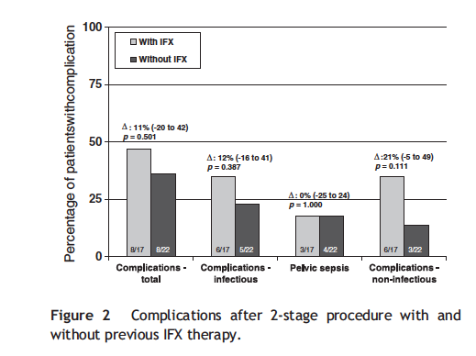
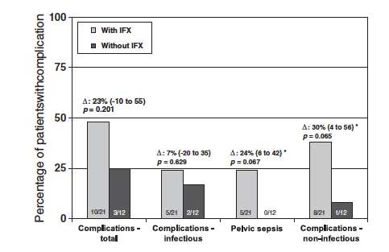
Evreli cerrahi sonuçları
TPC-IPAA
Tamamlama proktektomisi
Yüksek riskli hastalarda evrelendirilmiş cerrahi önerisi!
Notes:
İnfliximab kullani olan hastalrda tamamlama kolektomis sonrasidaha az komplikasyon gorulmekte

Slide 53
TAK ve Uç Ileostomi
Endikasyonlar
  Malnutrisyon
  Komorbiditeler
  Obezite
  Immune-module edici ajanlar
  Yüksek doz prednisone (>30 mg/gün)
  Ciddi hipoalbuminemi
  Derin anemi

Slide 54
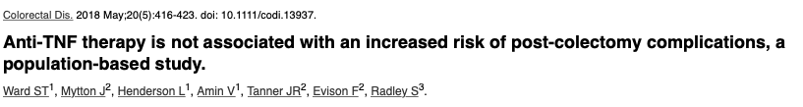
N=6225 ülseratif kolit hastası
N=753 anti-TNF kullanımı
Prosedür: Subtotal kolektomi
Komplikasyonlar üzerine etki yok
Notes:
Colorectal Dis. 2018 May;20(5):416-423. doi: 10.1111/codi.13937.
Anti-TNF therapy is not associated with an increased risk of post-colectomy complications, a population-based study.
Ward ST¹, Mytton J², Henderson L¹, Amin V¹, Tanner JR², Evison F², Radley S³.

Slide 55
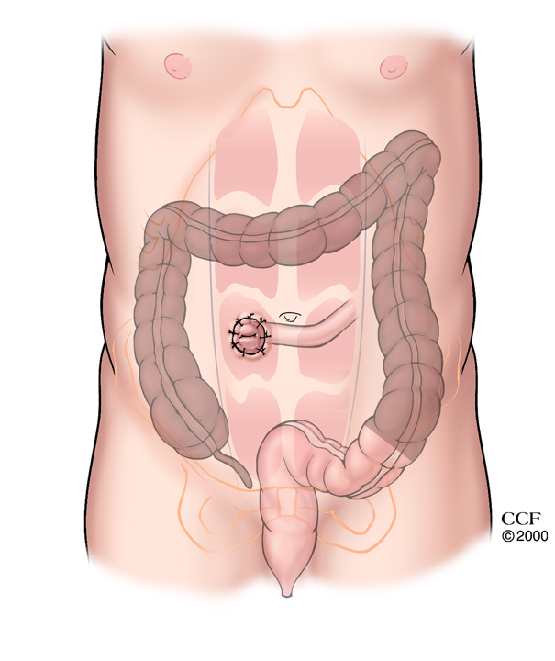
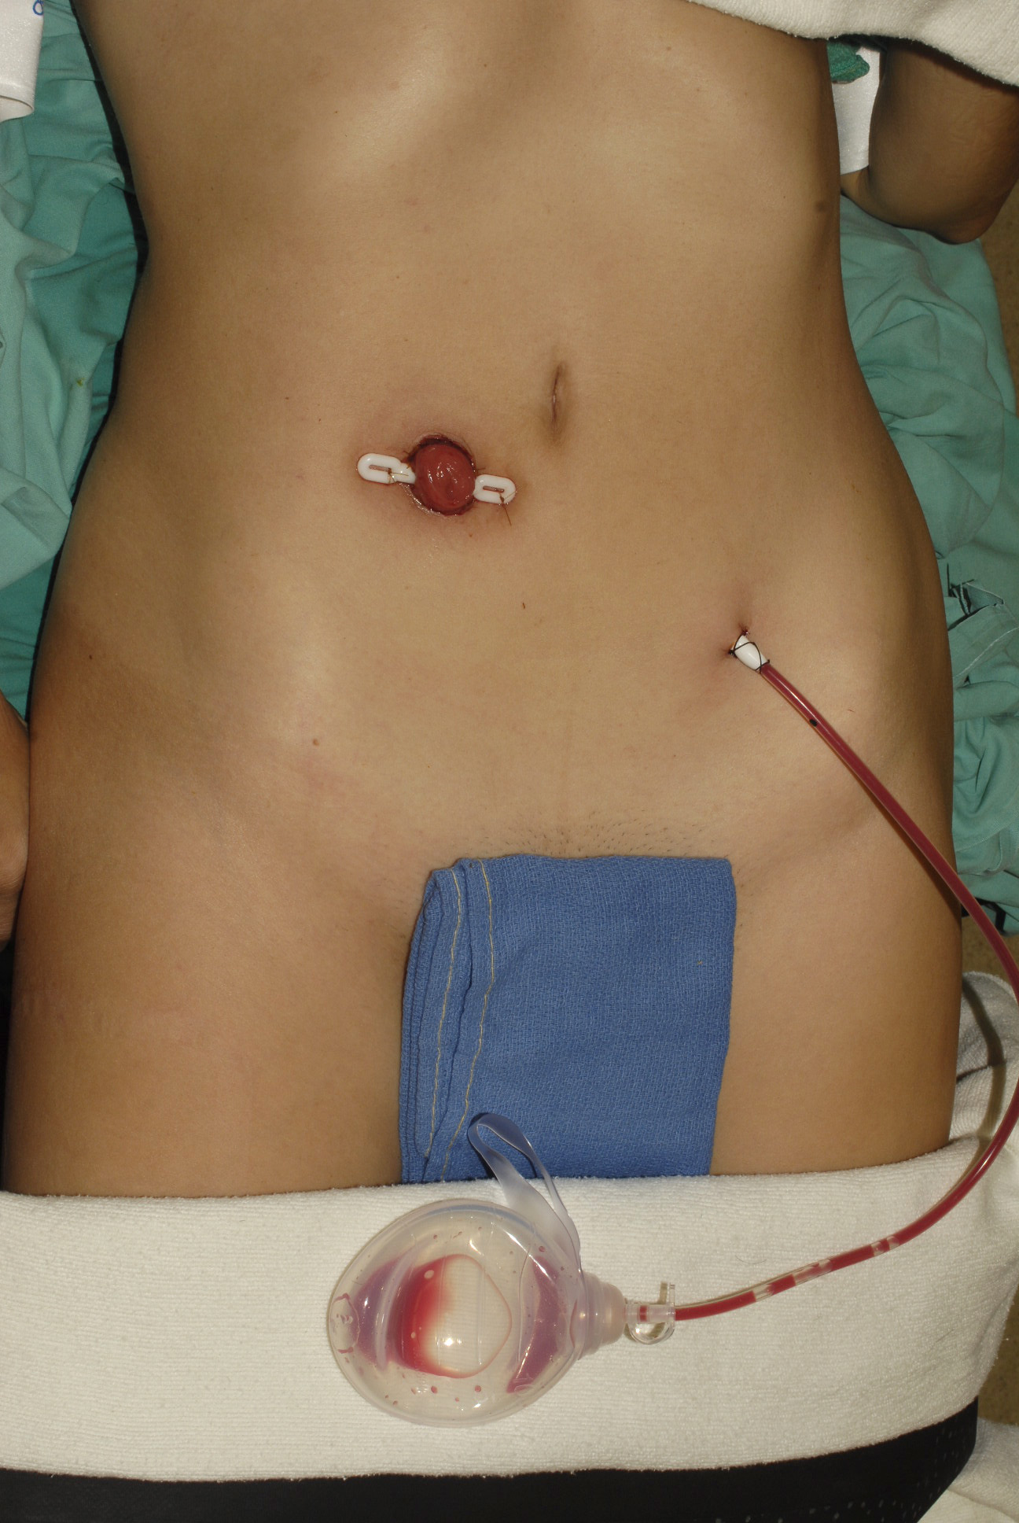
TAK ve Uç Ileostomi

Slide 56
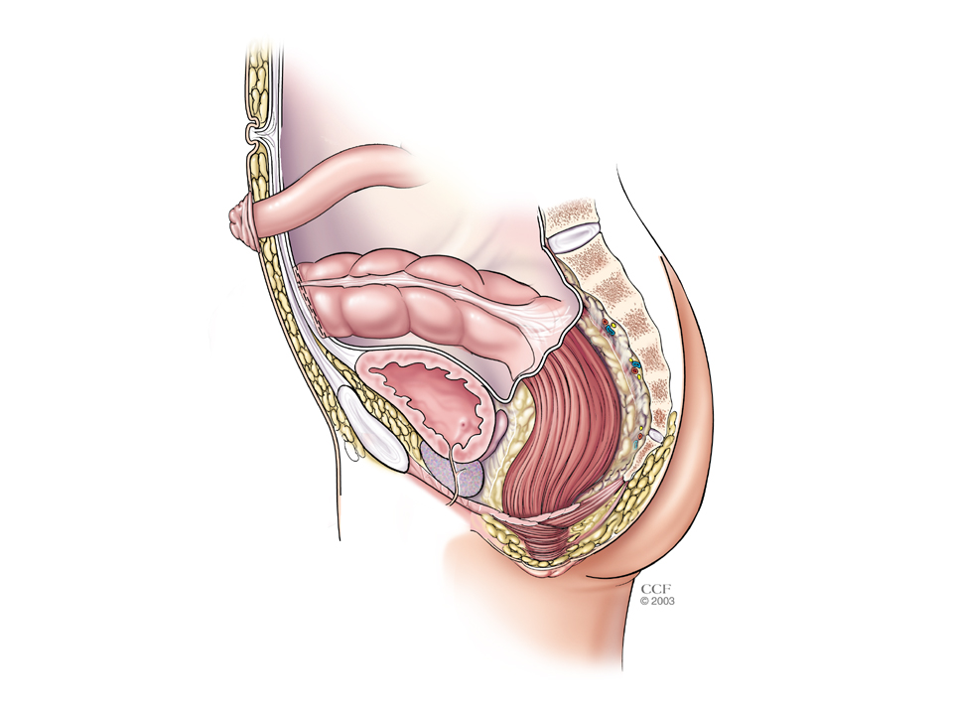

Slide 57

Sebze/meyve/omega-3 yağ asidinden zengin diyet CH ve UK gelişim riskini azaltır.
Enerji gereksinimi sağlıklı popülasyonda aynı
Protein gereksinimi aktif IBH’da artmakta (1.2-1.5 g/kg/gun)
Remisyonda ise protein gereksinimi genel popülasyonla ayni
Notes:
A diet rich in fruit and vegetables, rich in n-3 fatty acids, and
low in n-6 fatty acids is associated with a decreased risk of
developing Crohn's disease or ulcerative colitis and is therefore
recommended.
Grade of recommendation 0 e Strong consensus (90%
agreement)

Slide 58
İmmunonutrisyon IBH’da önerilmemektedir.
Crohn hastalığında distal (alt ieal/kolonik) ve düşük volümlü fistüller nutrisyonel destek enteral yolla, proksimal/yüksek volümlü fistüllerde PN verilmelidir.
Notes:
.

Slide 59


Slide 60
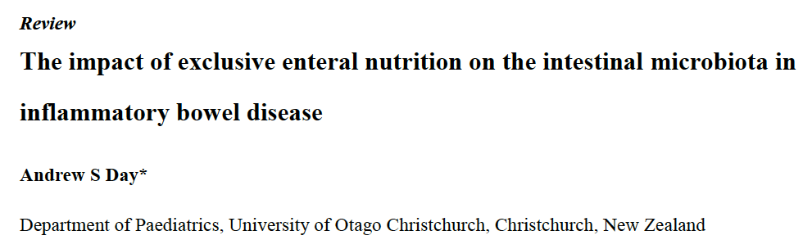

Mikrobesin eksikliği yönünden değerlendirilmeli ve eksikler yerine konulmalıdır.
Aktif hastalıkta genel olarak önerilebilecek spesifik ‘IBH diyeti’ yoktur.
Notes:
Lately, there is interest in specific carbohydrate, paleolithic,
gluten-free, low FODMAP, u-3 PUFA enriched and other diets in active IBD. However RCT data regarding the effects of experimental
diets on intestinal inflammation or on inducing remission are still
lacking at this tim
fermente edilebilir kısa zincirli karbonhidrat içeren besinlerin diyetteki miktarını en aza indirgemektedir.

Slide 61

Mikrobesin Eksikliği

Slide 62
Intestinal striktur/stenozu olan Crohn hastalarinda düşük miktarda (çözülemeyen) fiber iceren diyet önerilmelidir.
Aktif hastalığı olan ve steroid tedavisi alan IBH hastalarinda serum Ca ve 25(OH) vit D düzeylerine bakılmalı ve eksikliği giderilmelidir.
Notes:
.

Slide 63

Kontrendike olmadığı sürece nutrisyonel destek enteral yolla verilmelidir.
Exclusive enteral nutrisyon efetif olup aktif CH remisyonun sağlamamasında birinci basamak tedavi olarak özellikle çocuklarda etkilidir.
Notes:
.

Slide 64


Slide 65


Slide 66
Elektif cerrahi IBH olgularında ERAS protokolleri kullanılabilir.
Acil cerrahi olgularda hasta malnutre ise yada oral alim postop 7 gün boyunca mümkün olmayacaksa nutrisyonel destek (EN, PN) verilmelidir.
Notes:
.

Slide 67
Malnutriyon tanısı konulan IBH hastalarında mümkünse cerrahi 7-14 gün ertelenerek yoğun nutrisyonel destek verilmelidir.
20 cm’den fazla distal ileum rezeksiyonu yapıldığında vit B12 desteği sağlanmalıdır.
Sulfsalazin ve metotreksat ile tedavi edilen IBH hastalarında folik asit desteği verilmelidir.
Notes:
.

Slide 68
Özetle
Her İBH hastası nutrisyonel acıdan taranmalı/değerlendirilmeli/müdahale edilmeli
İnflamasyon aracılı etiyopategenez (GLIM malnutraisyon kriterleri)
İBH’de primer ve destek tedavisinde standart EN verilmeldir
Mikronutriuent eksikliği mutlaka değerlendirmeli
Yüksek riskli hastalarda cerrahi strateji değiştirilmeli/ertelenmeli

